Slide 1
Healic Risk Score Summary

Slide 2
Univariate Analysis

Slide 3
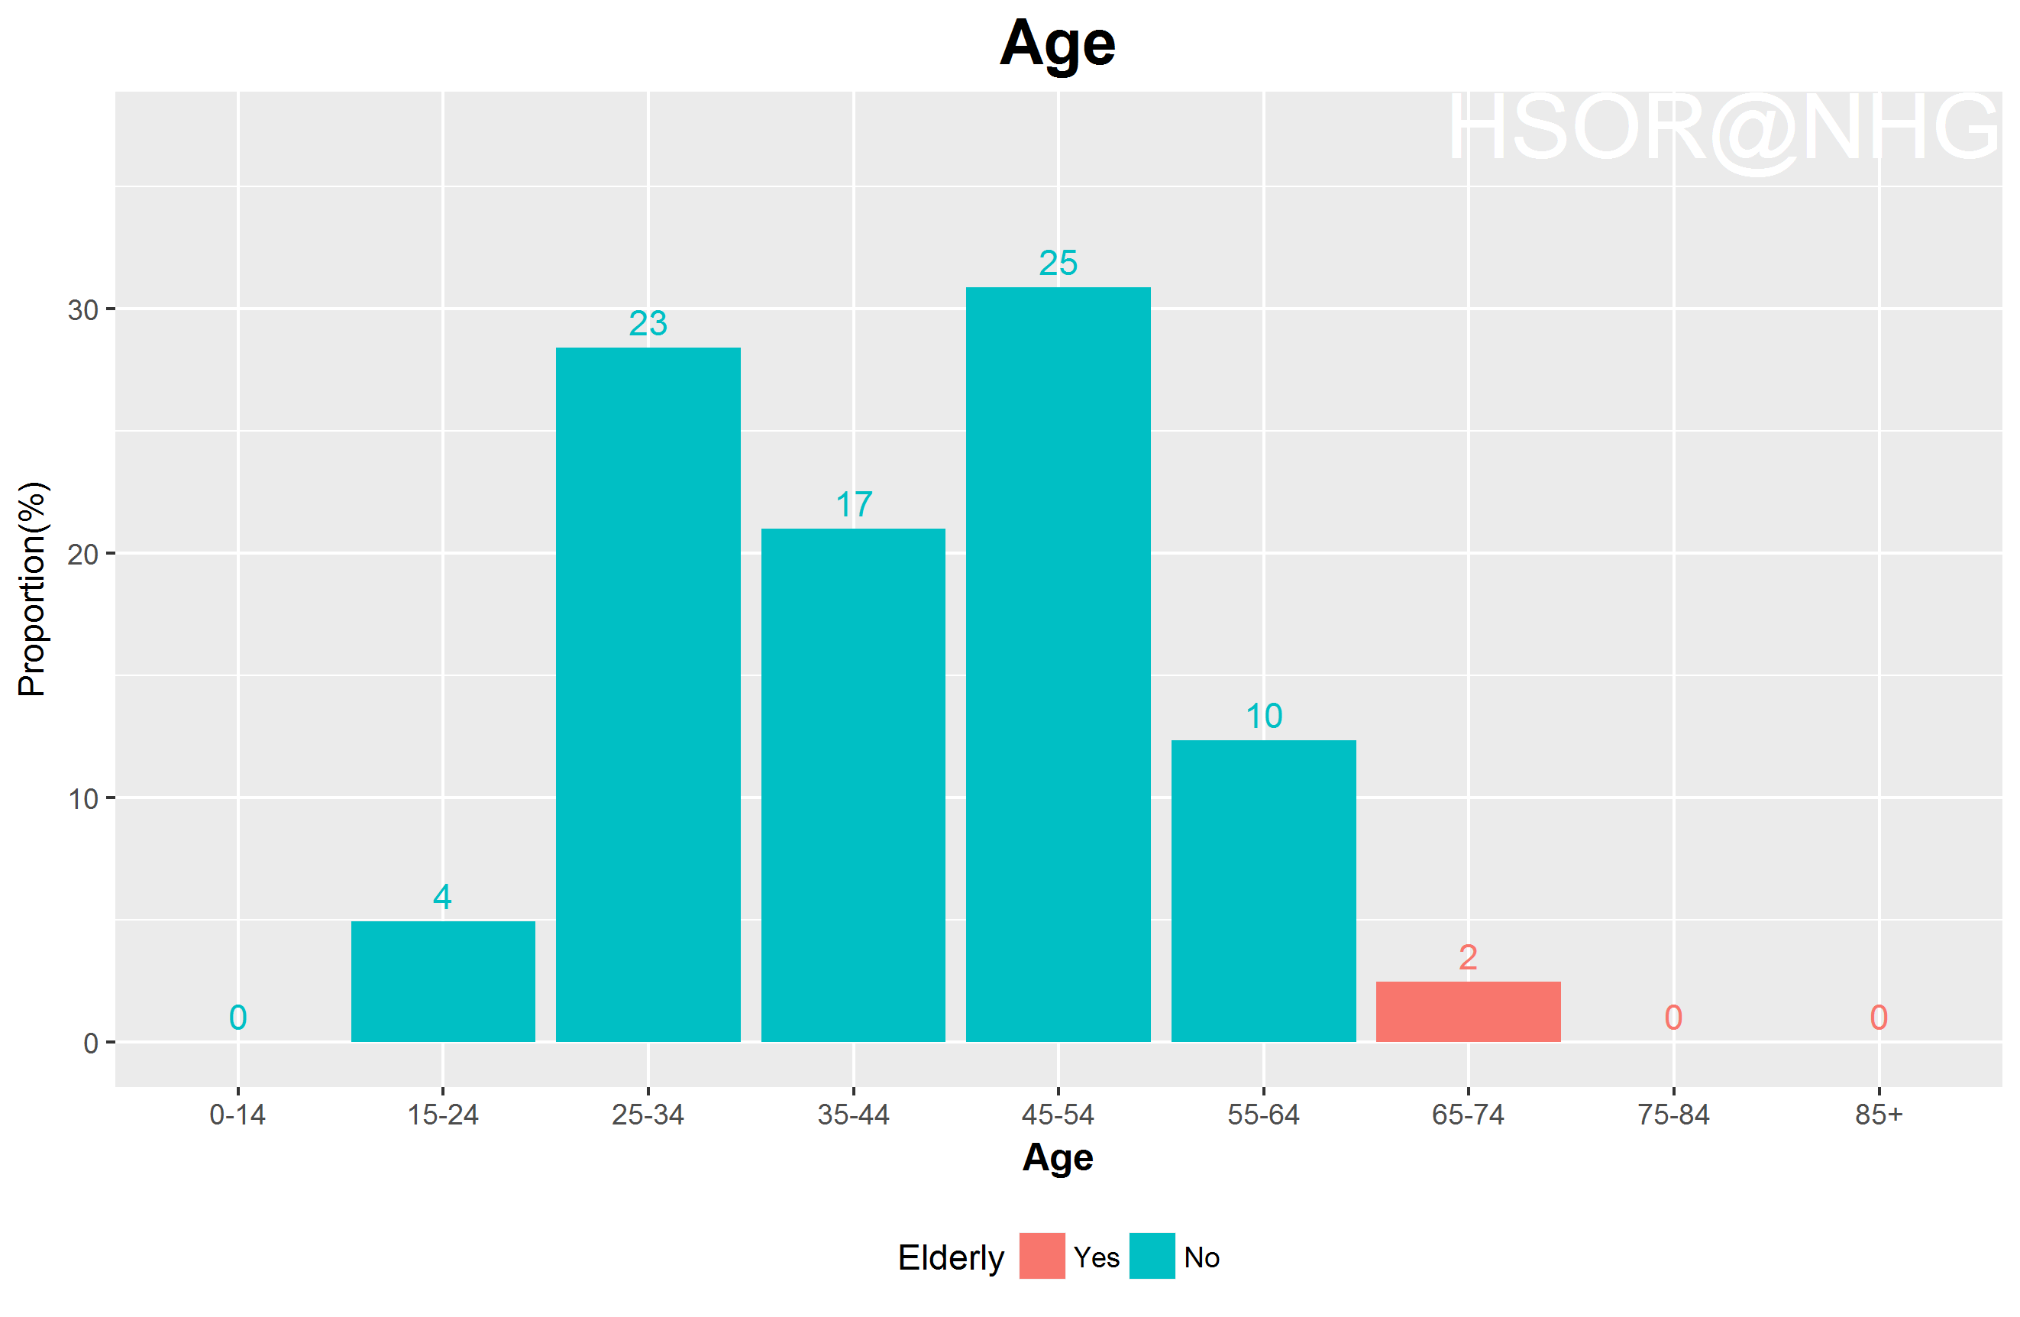
Age distribution

Slide 4
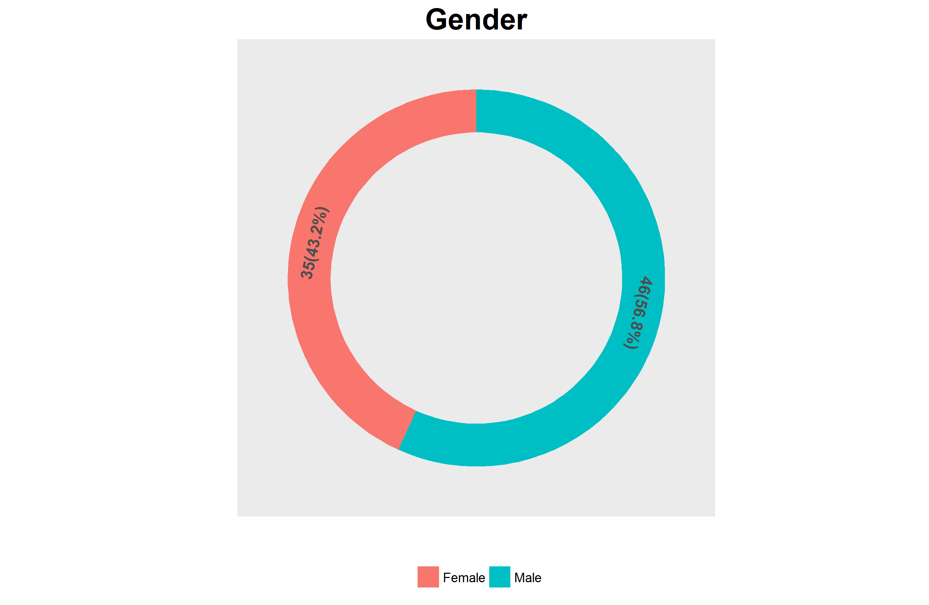
Gender distribution

Slide 5
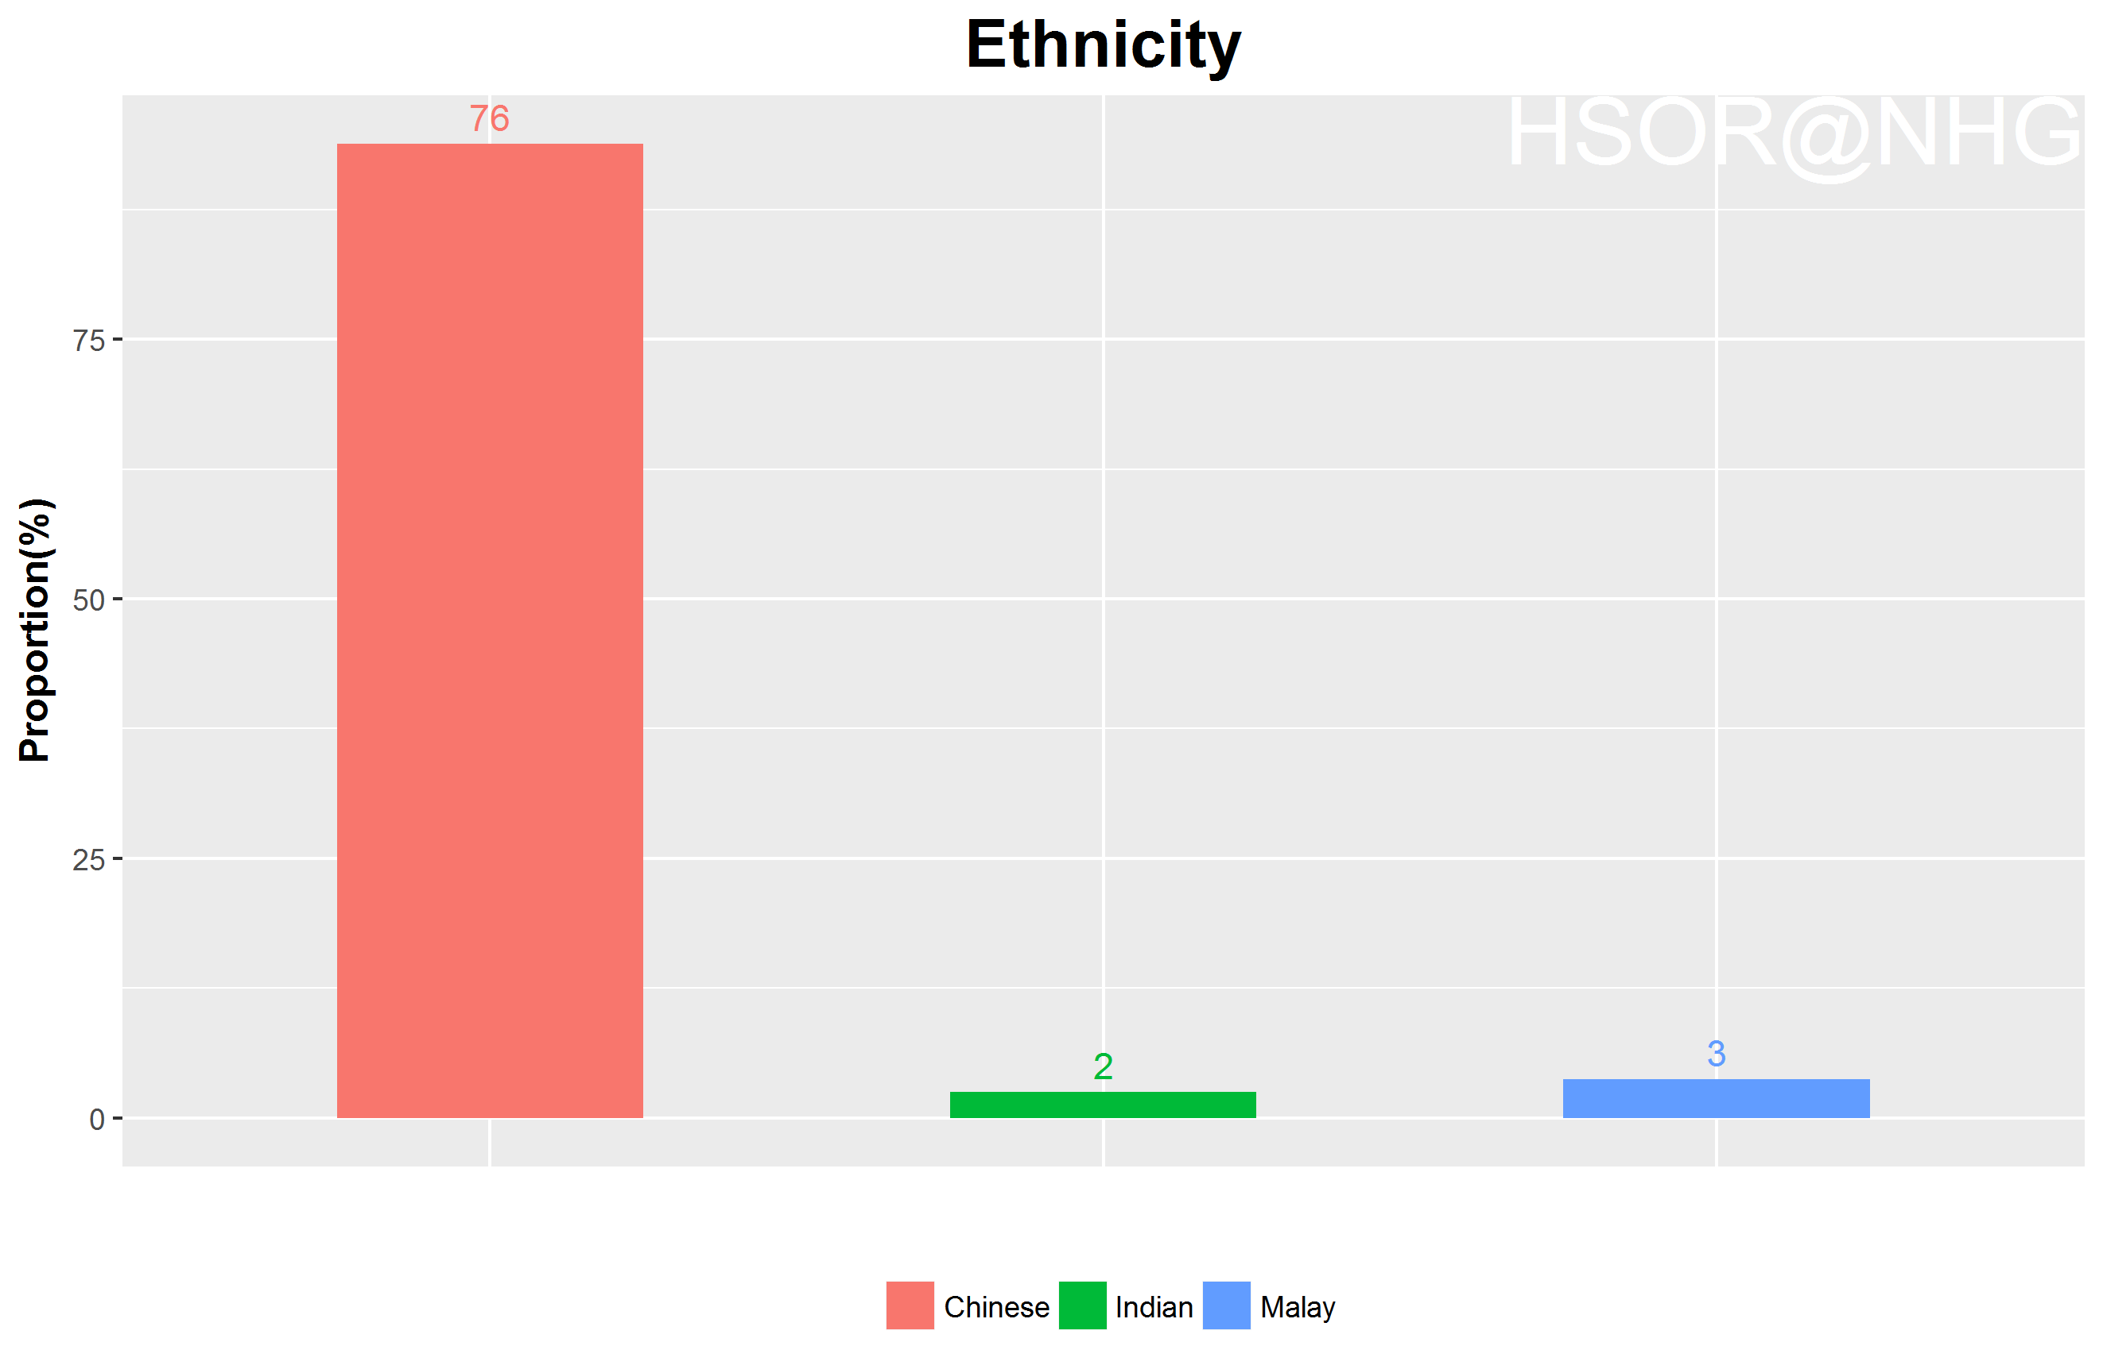
Ethnicity distribution

Slide 6
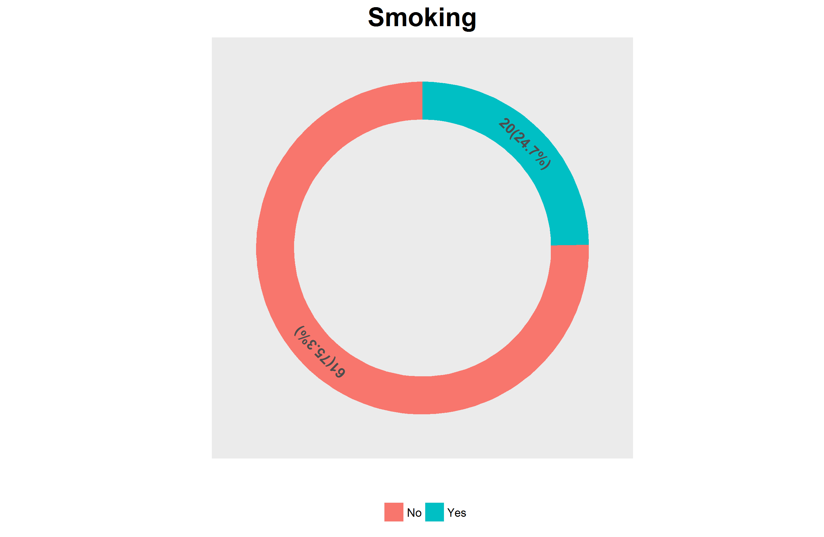
Smoking status distribution

Slide 7
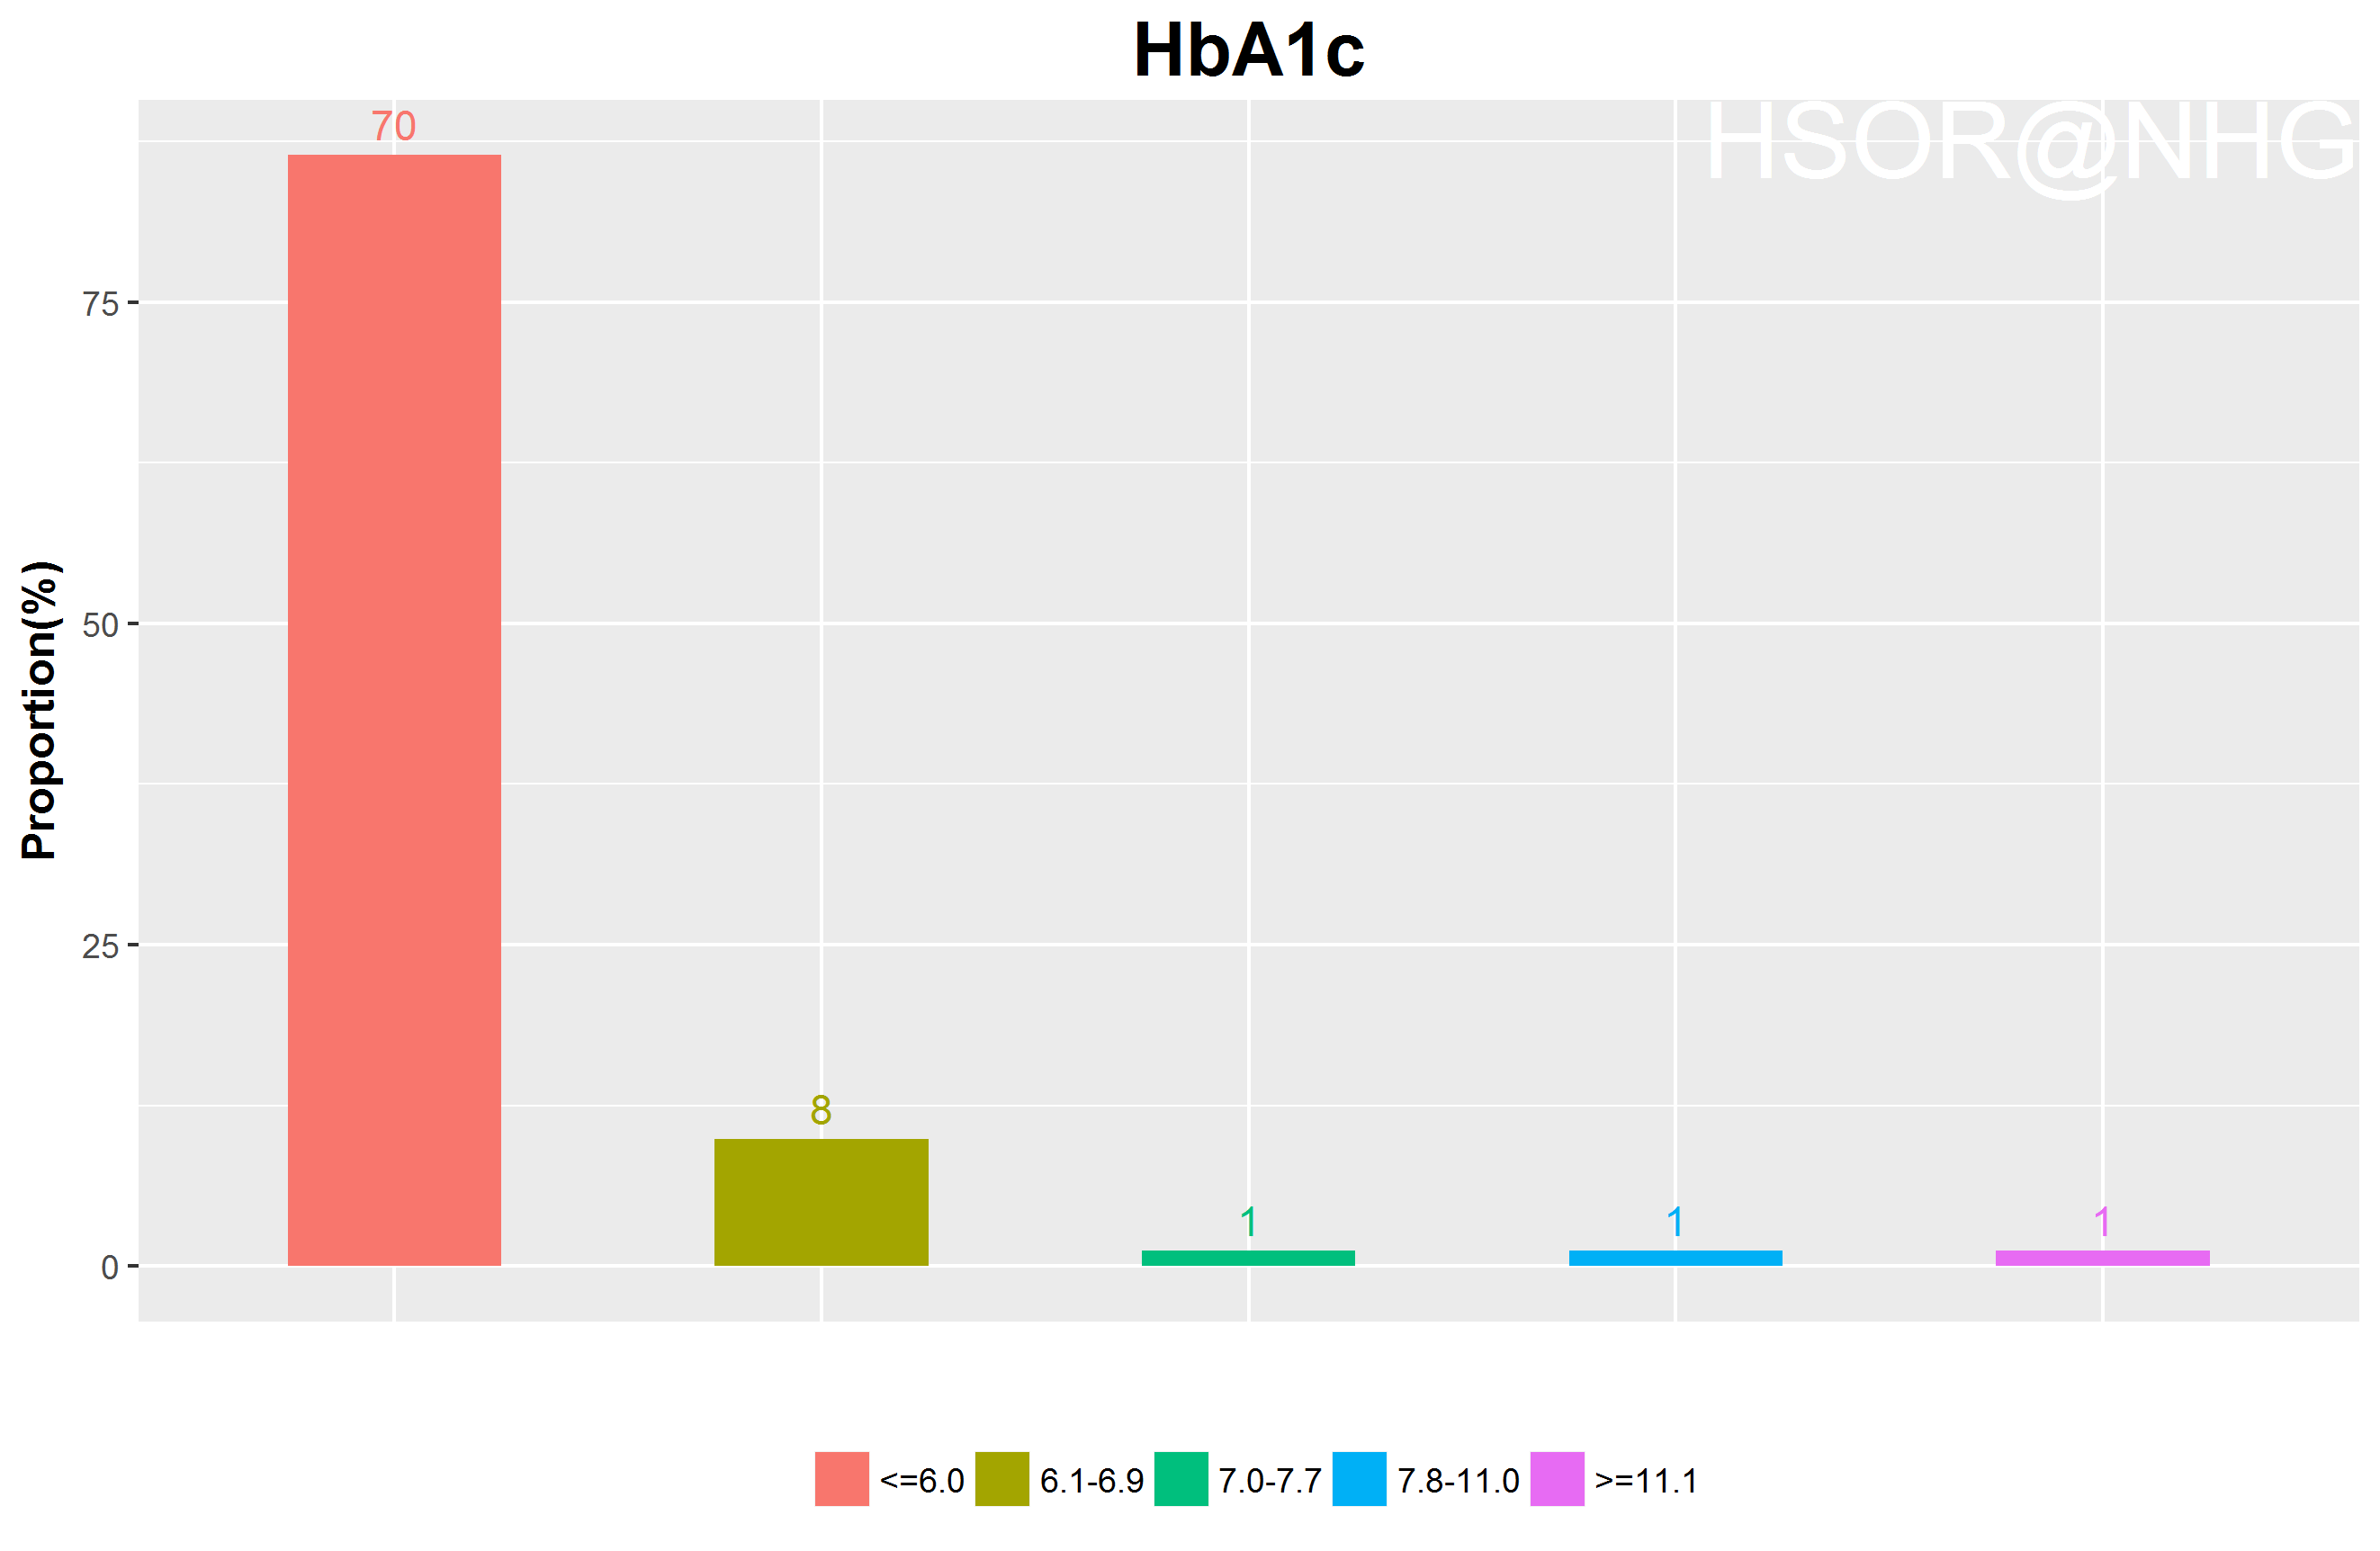
HbA1c distribution

Slide 8
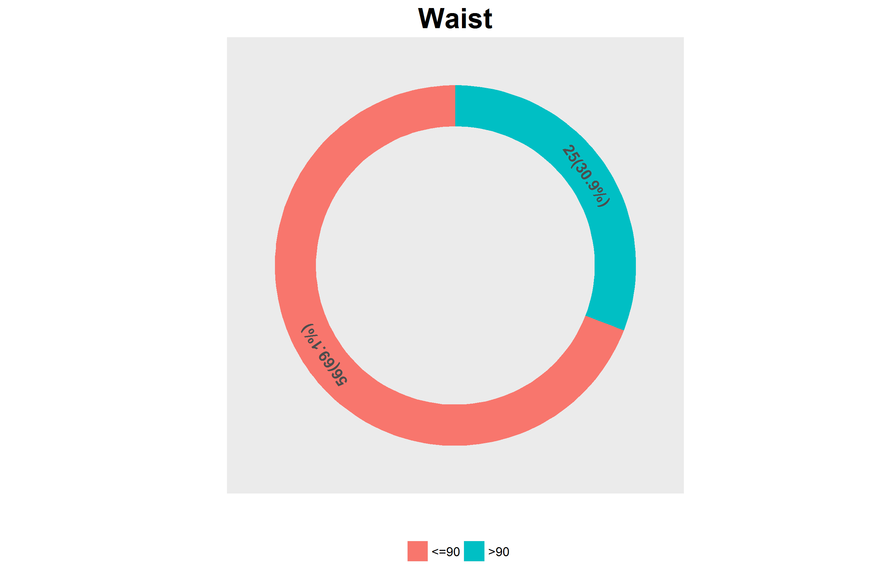
Waist distribution

Slide 9
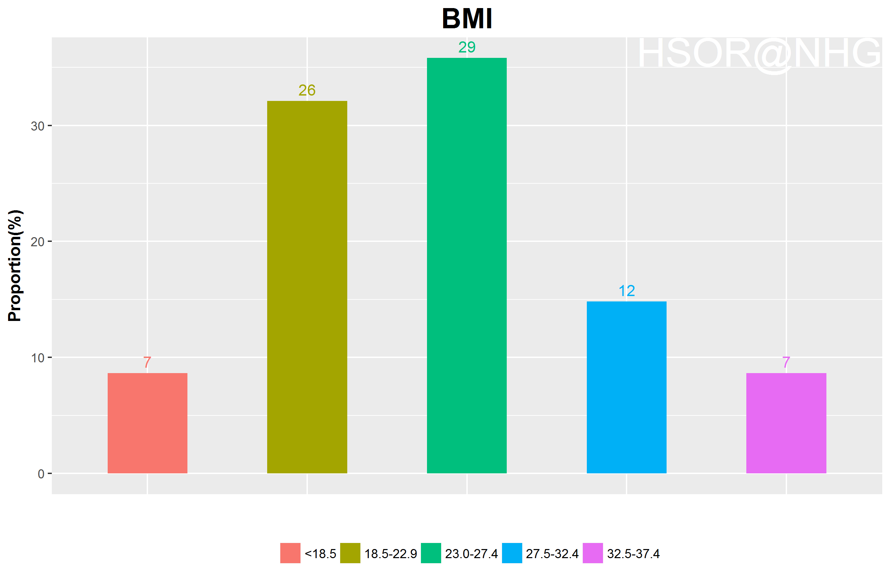
BMI category distribution

Slide 10
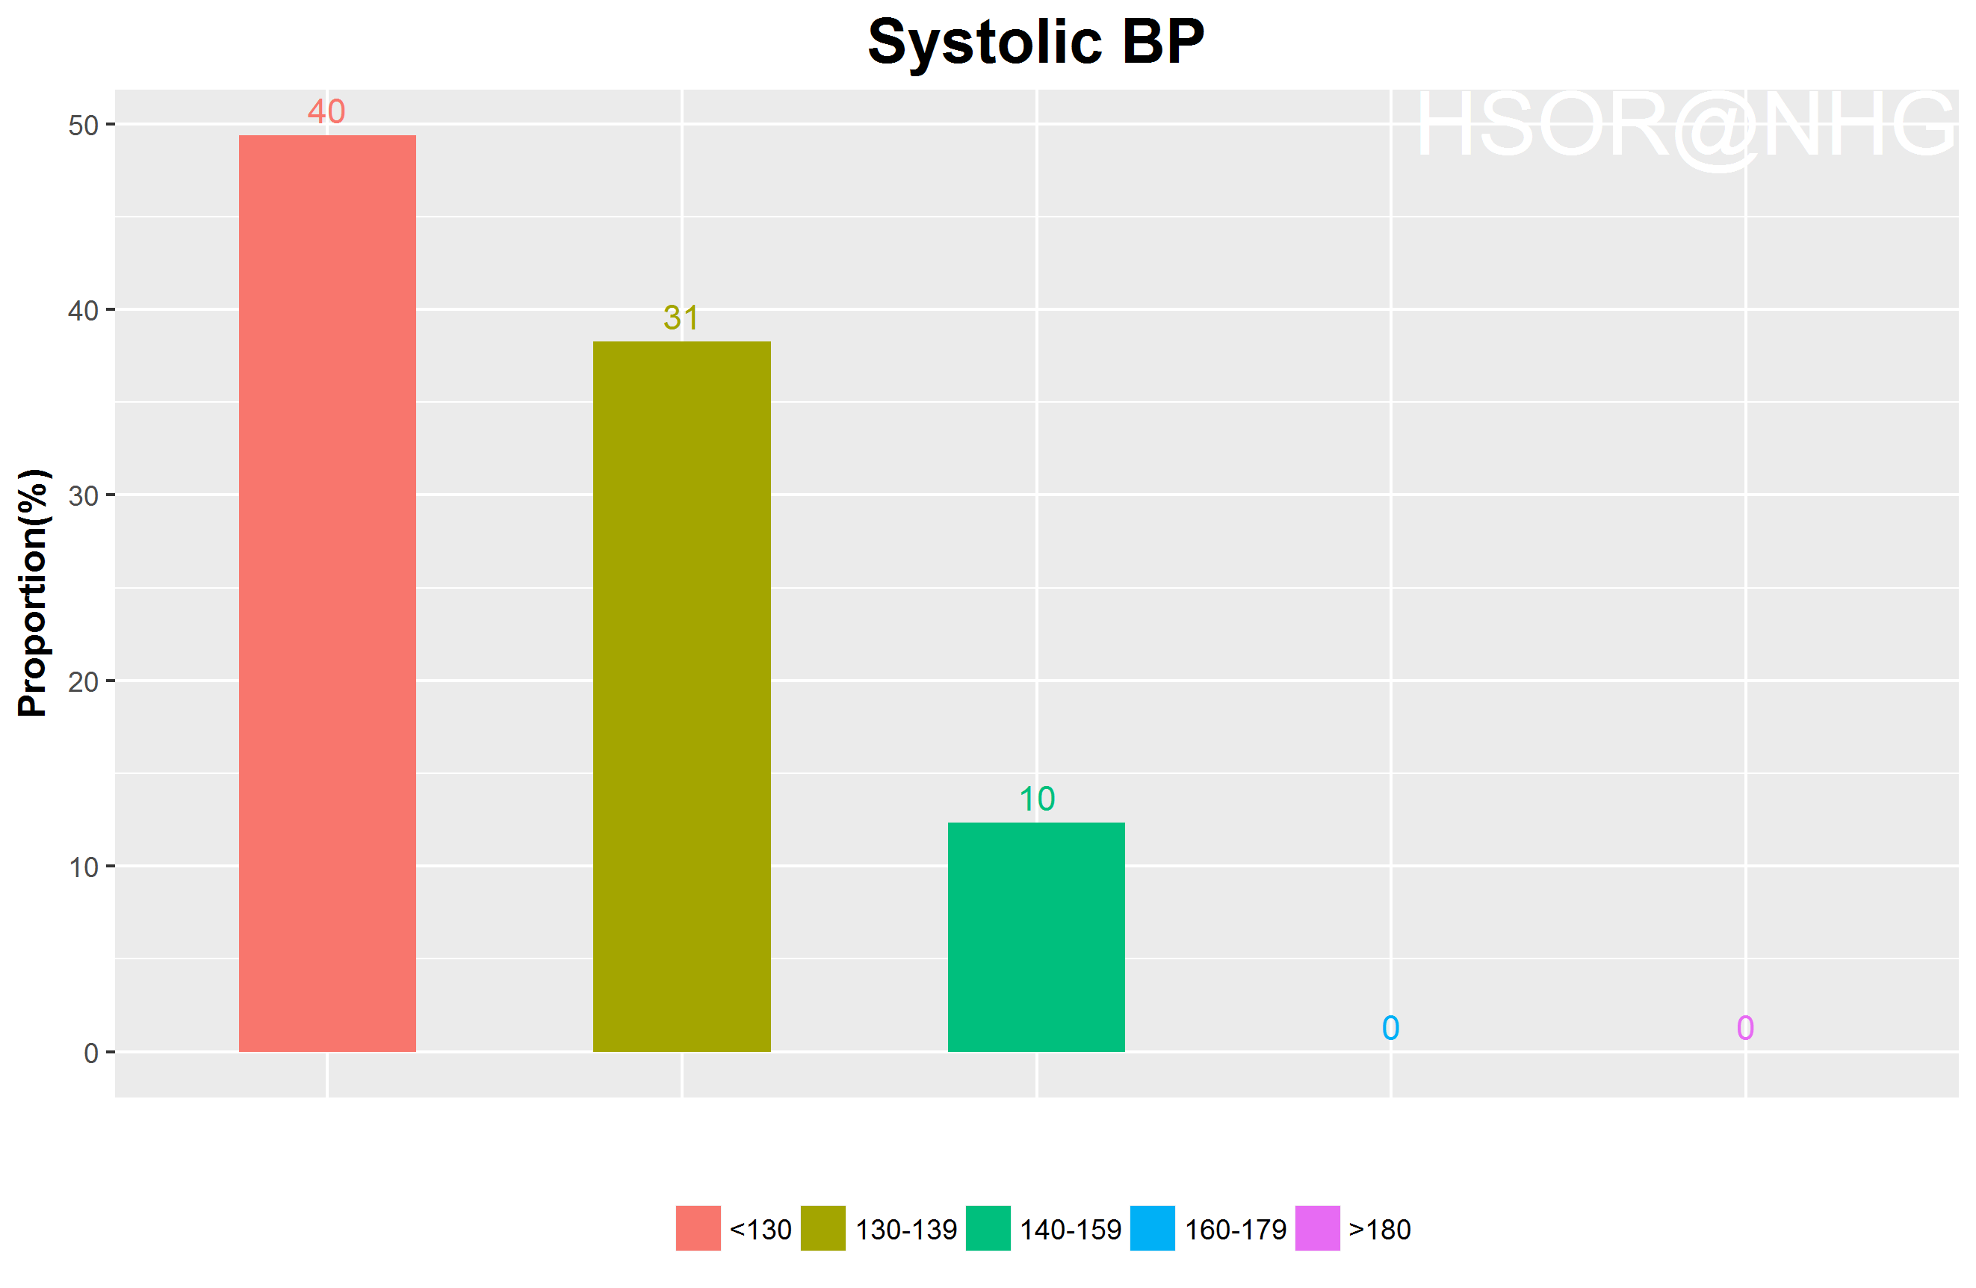
Blood Pressure (Sys) distribution

Slide 11
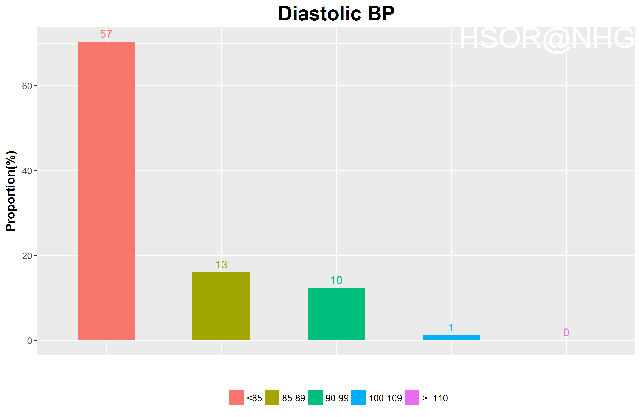
Blood Pressure (Dia) distribution

Slide 12
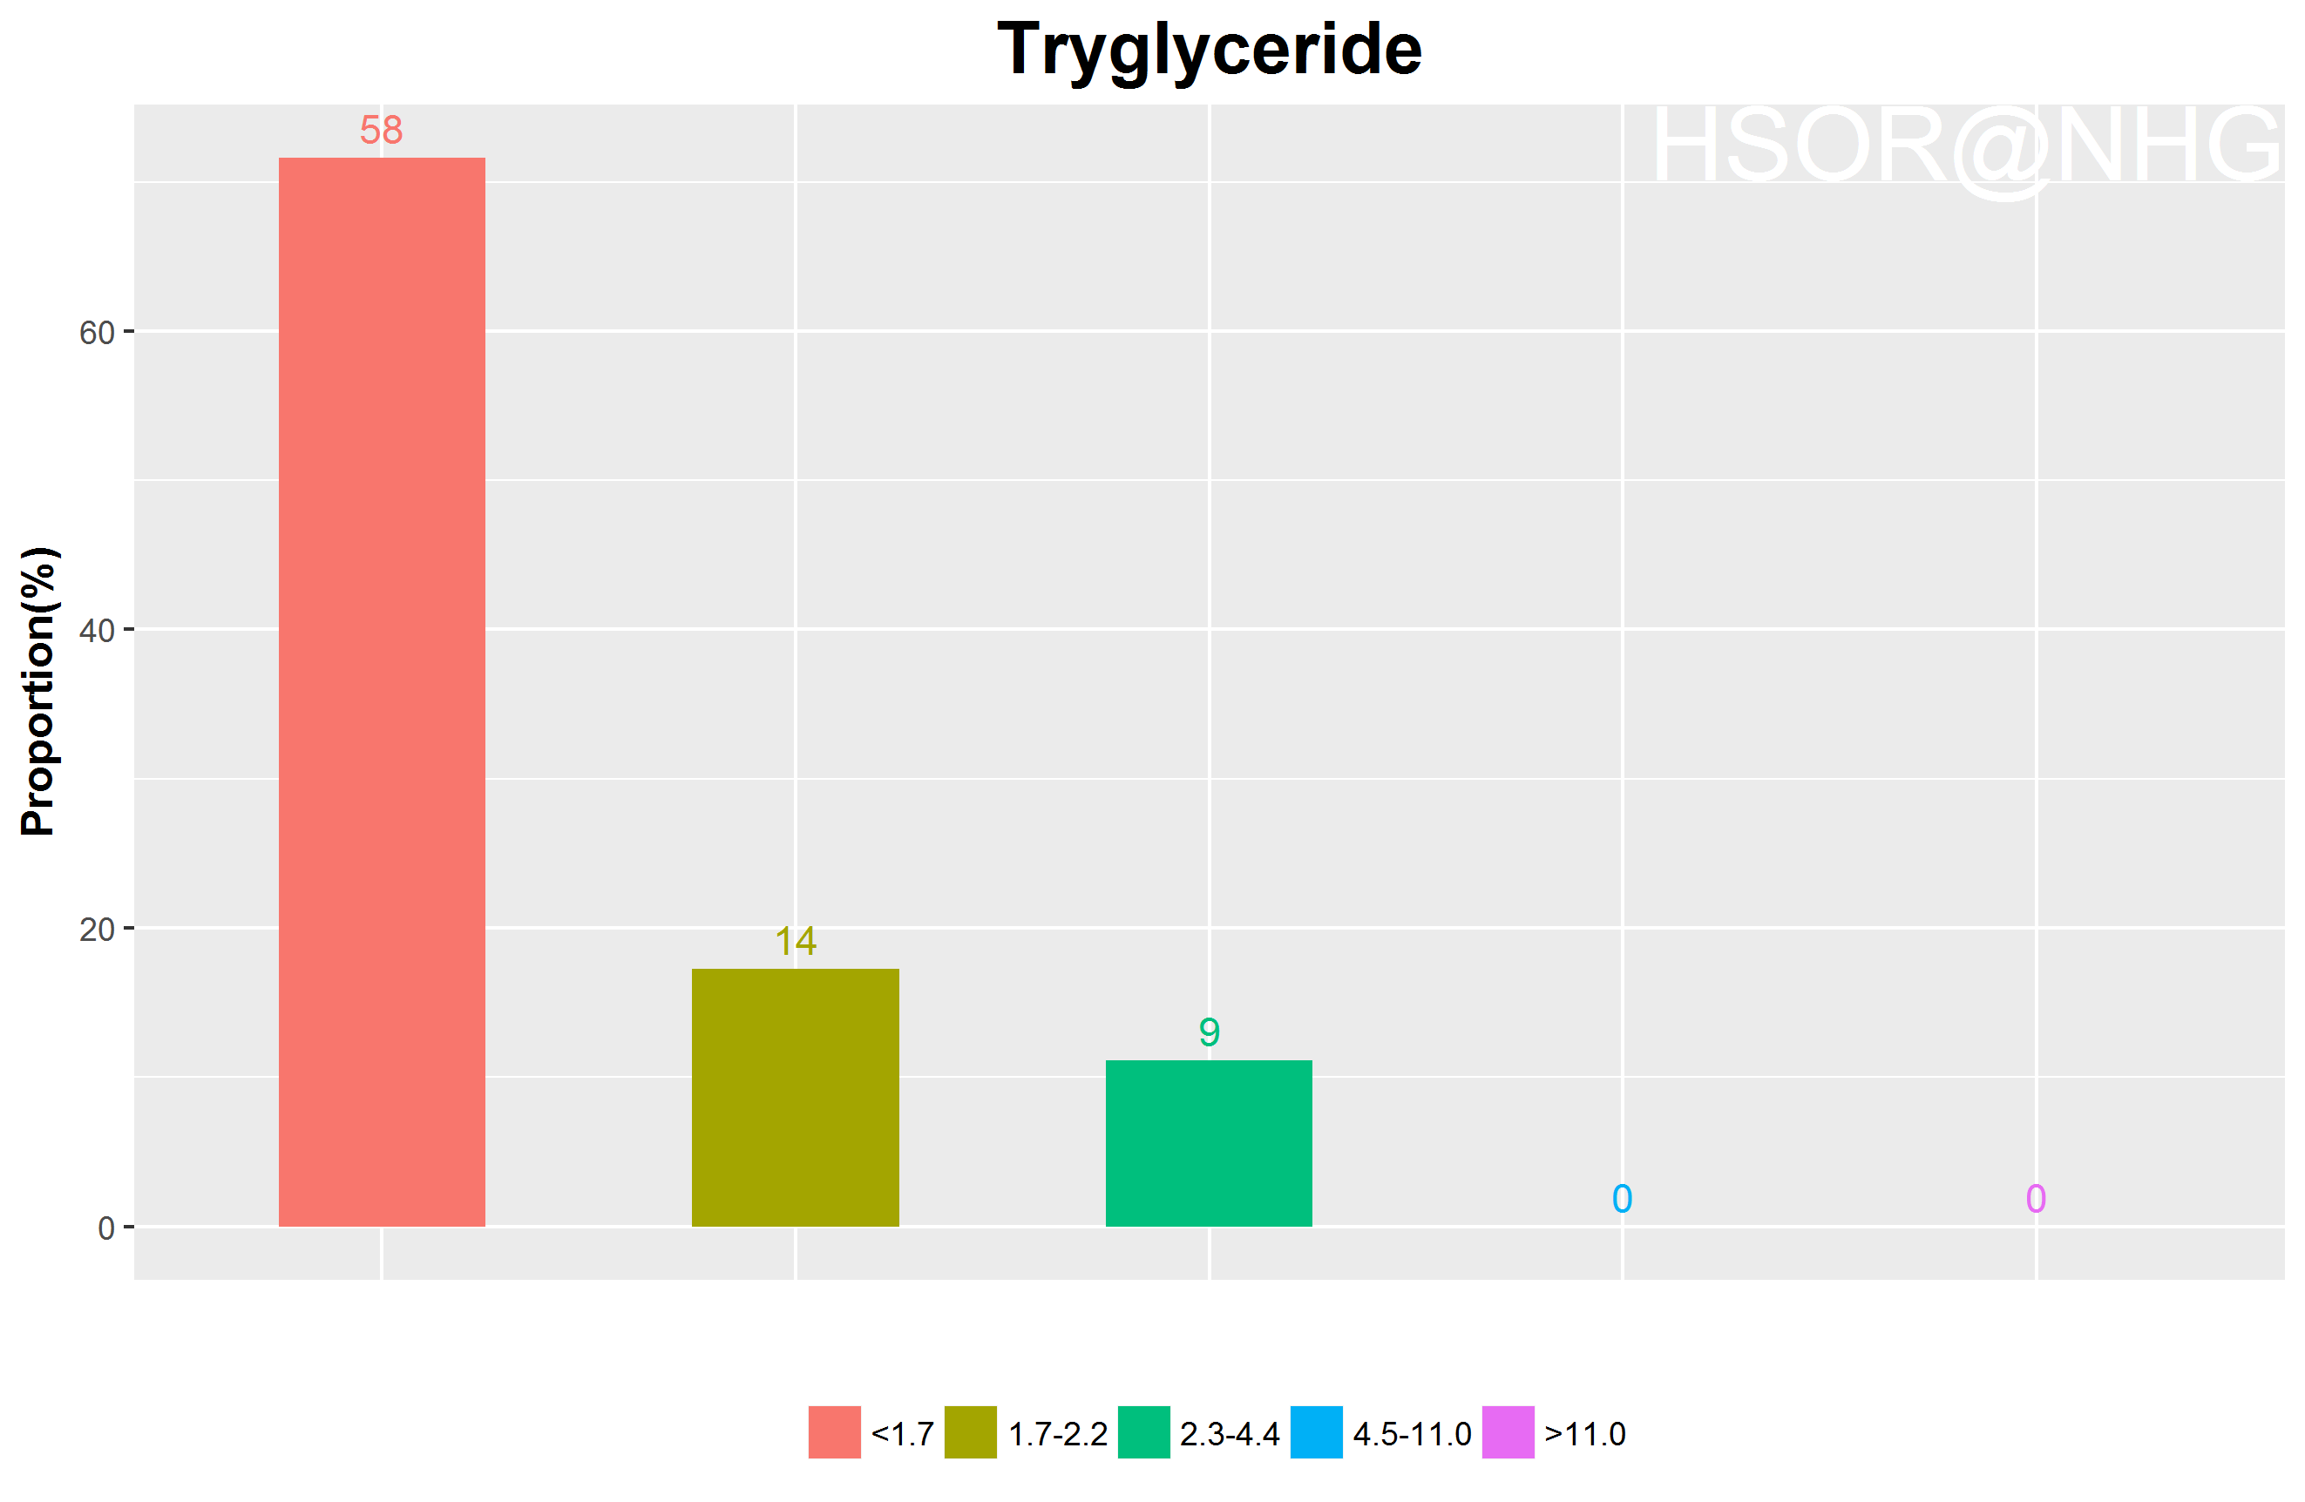
Tryglyceride distribution

Slide 13
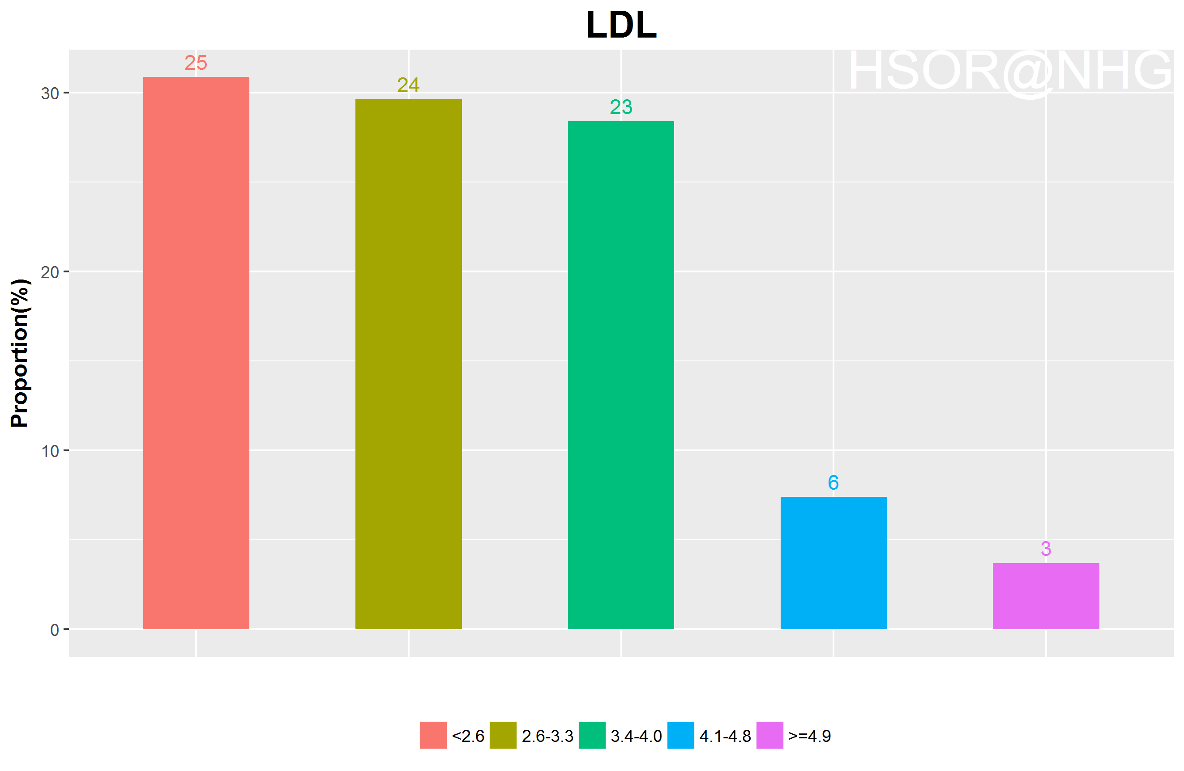
LDL distribution

Slide 14
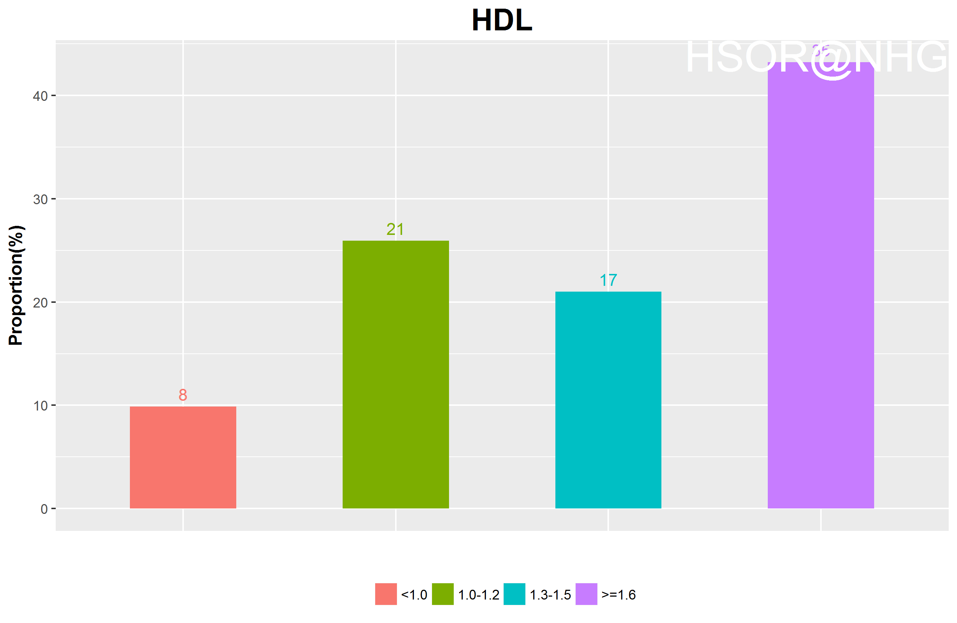
HDL distribution

Slide 15
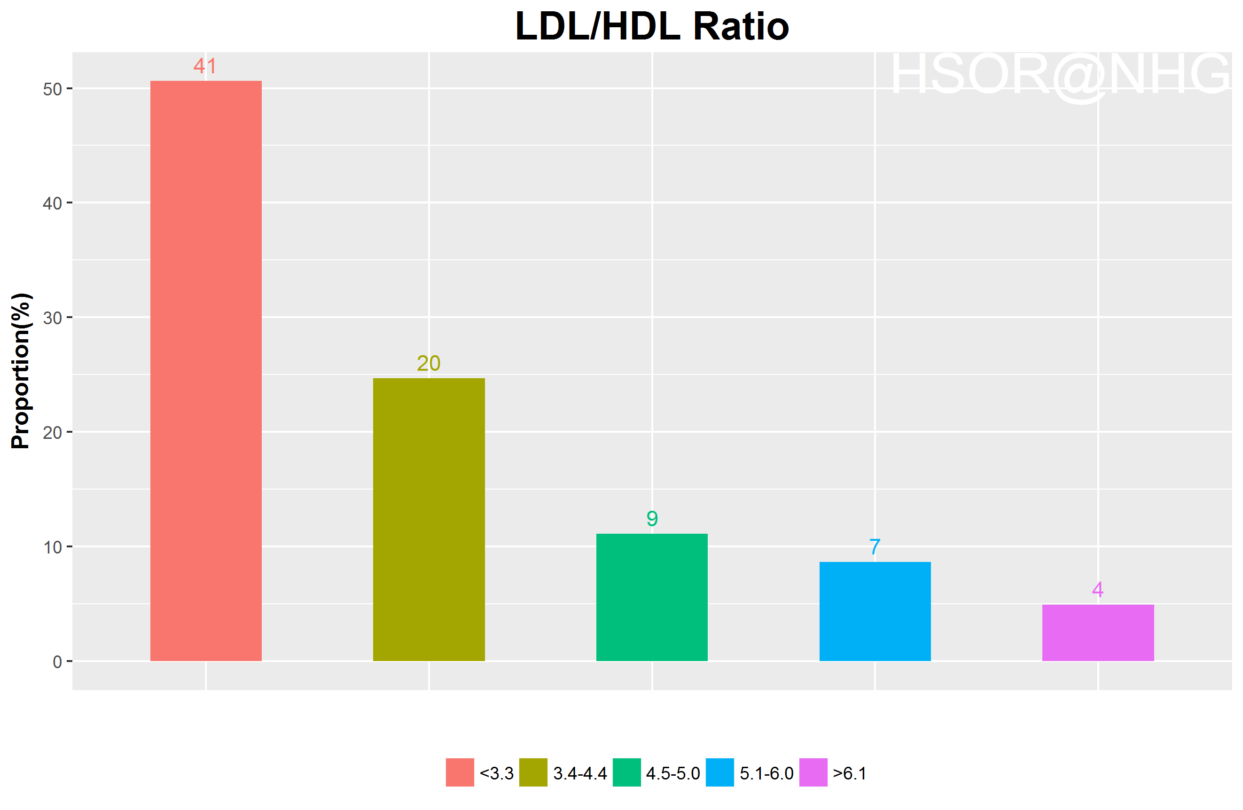
LDL/HDL ratio distribution

Slide 16
Healic risk category distribution

Slide 17
Risk Factor vs Risk Category

Slide 18
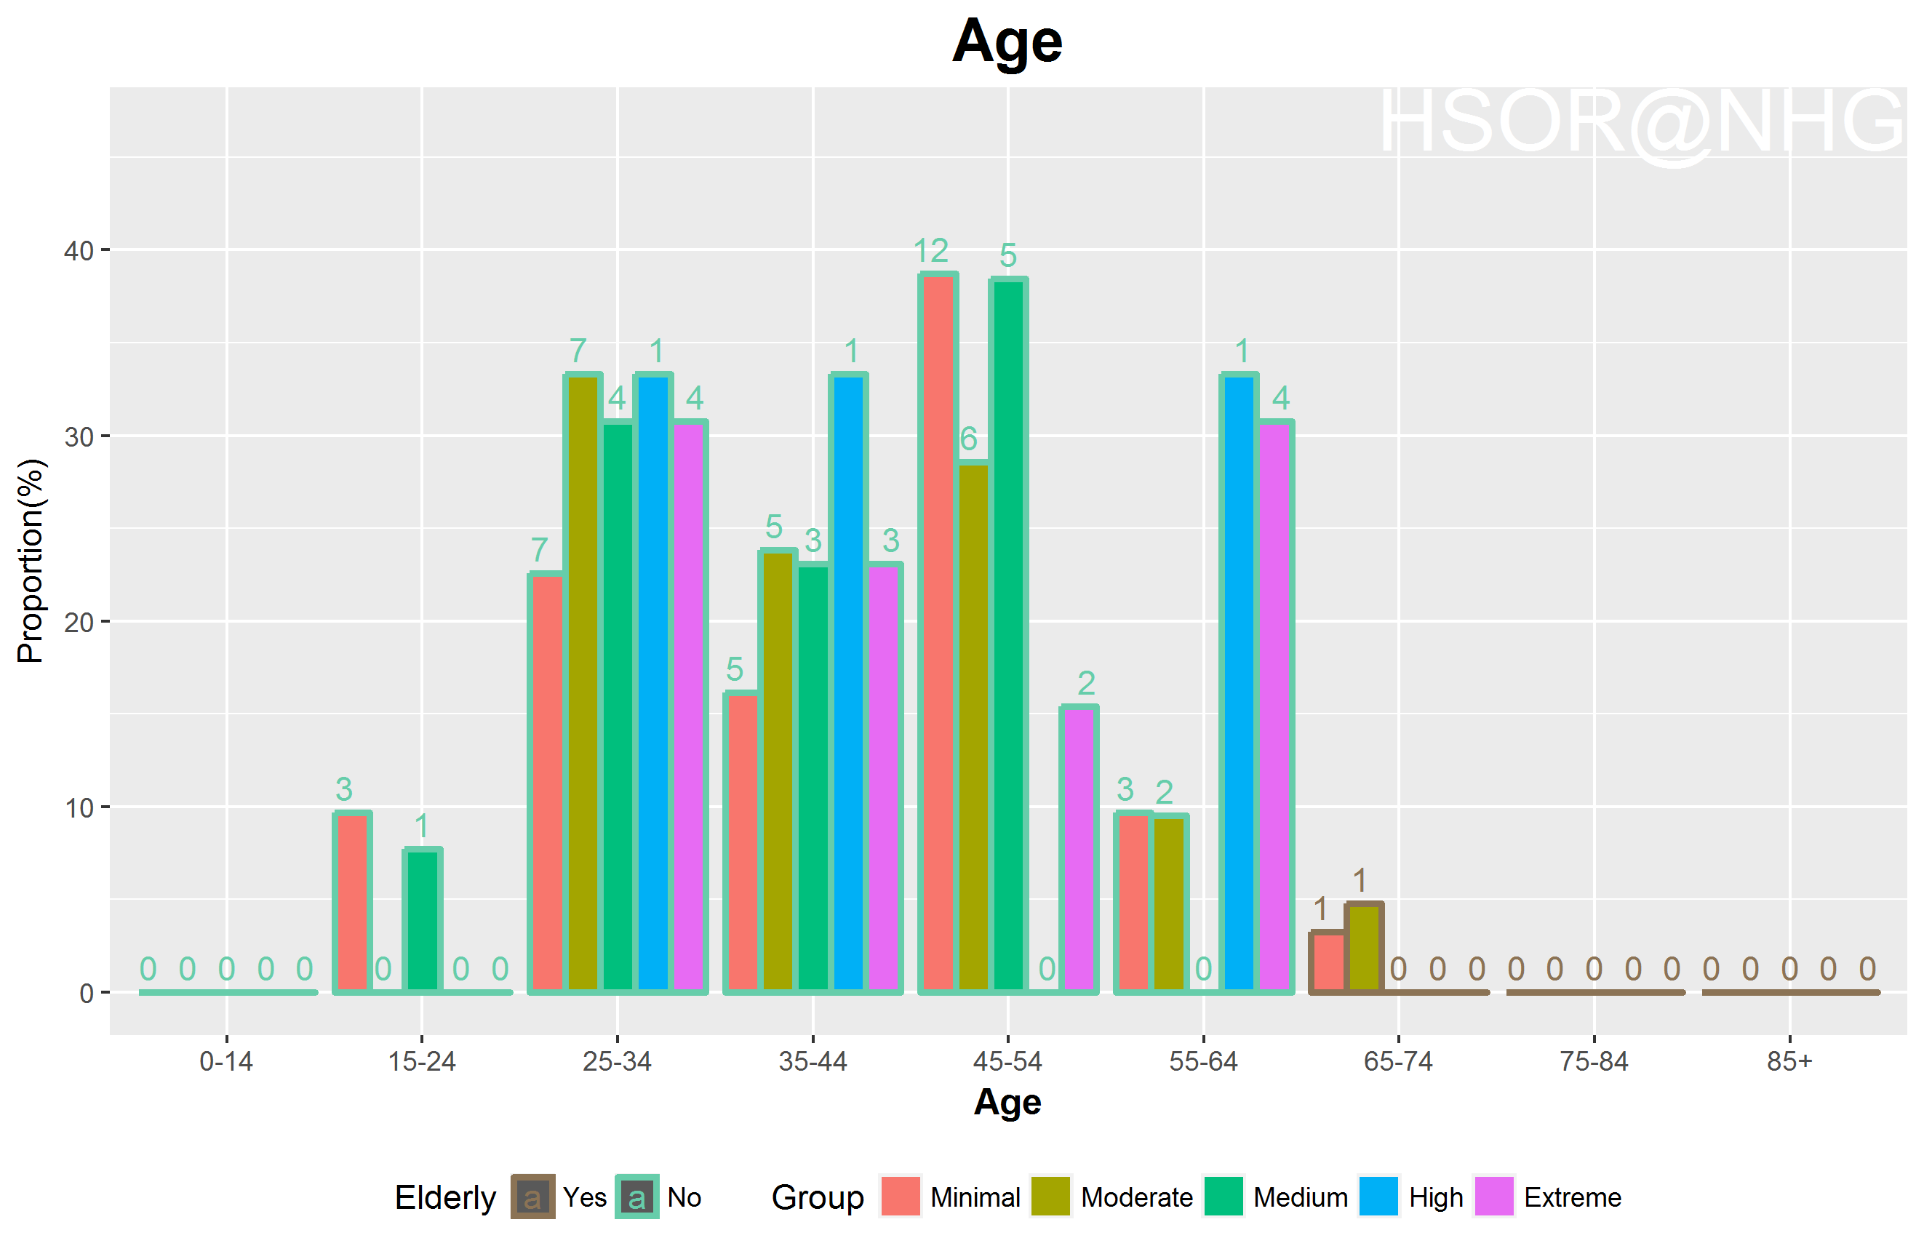
Age vs risk cat.

Slide 19
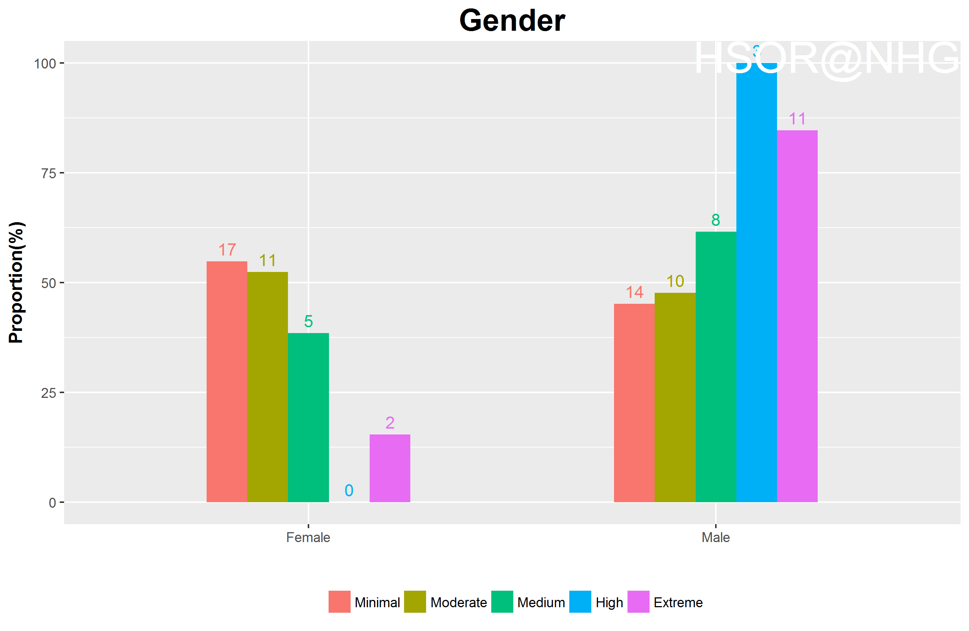
Gender vs risk cat.

Slide 20
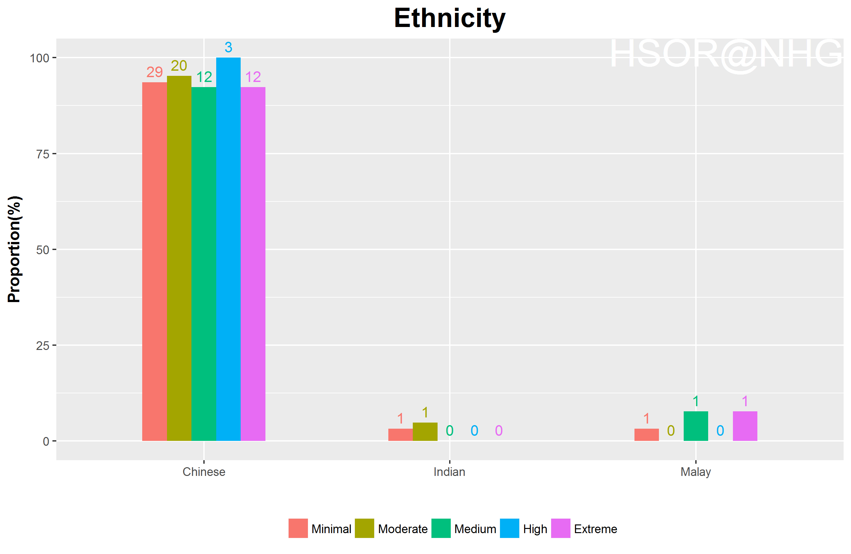
Ethnicity vs risk cat.

Slide 21
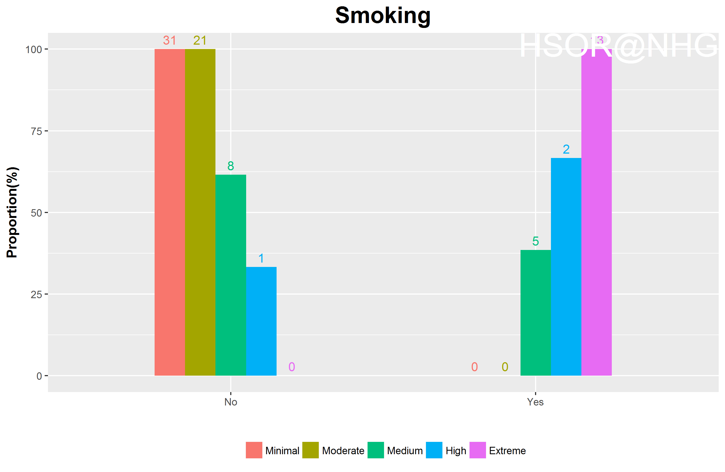
Smoking status vs risk cat.

Slide 22
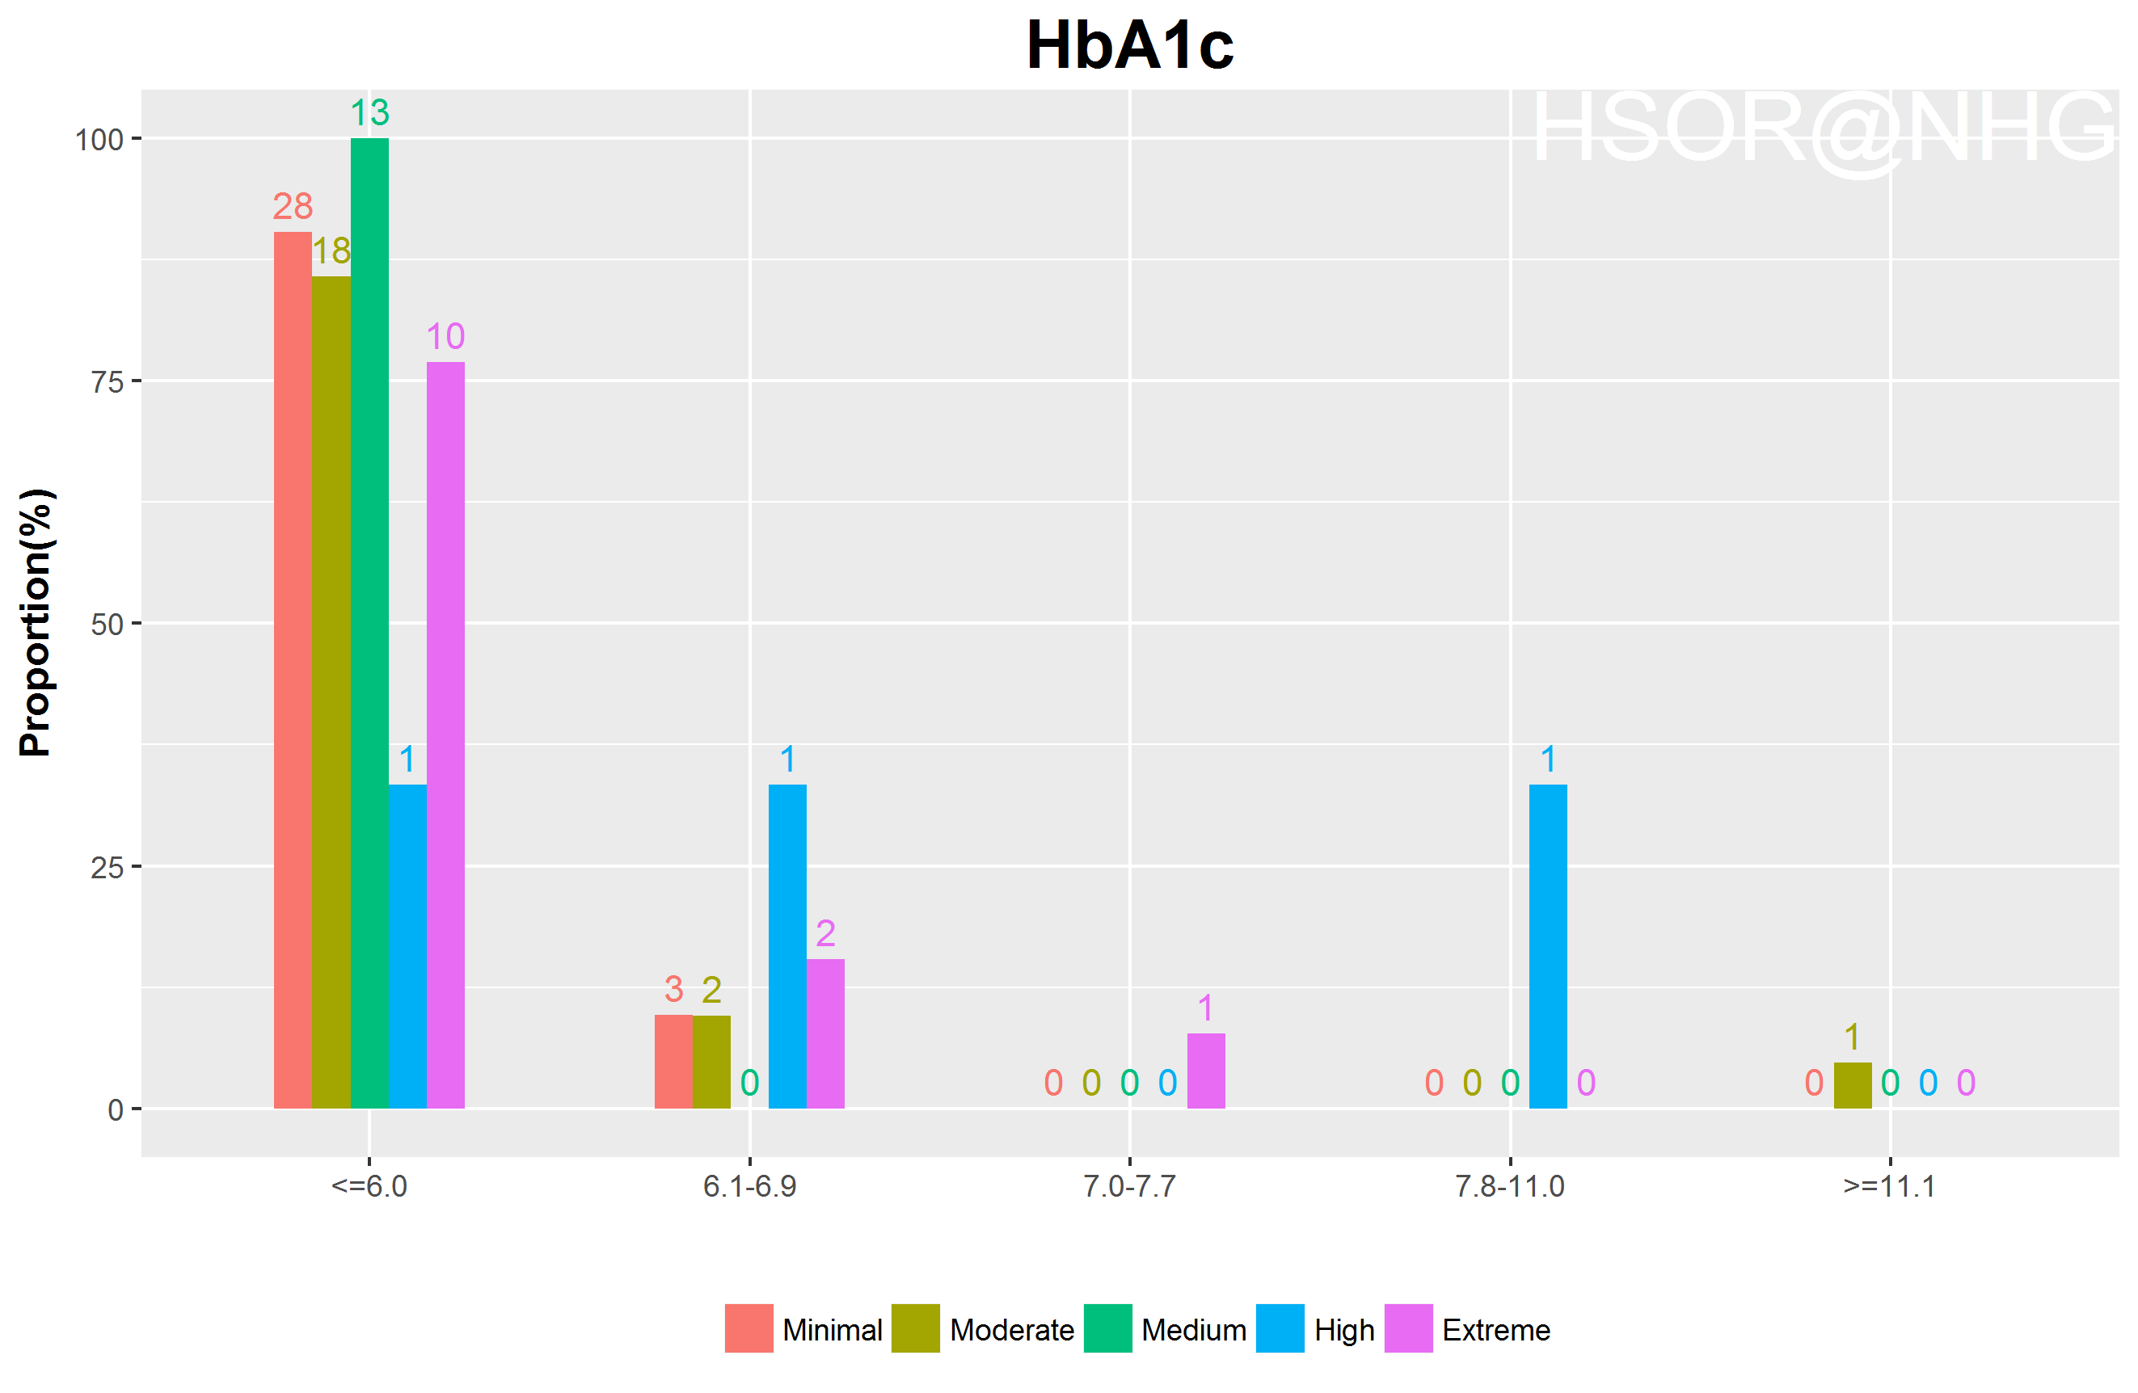
HbA1c vs risk cat.

Slide 23
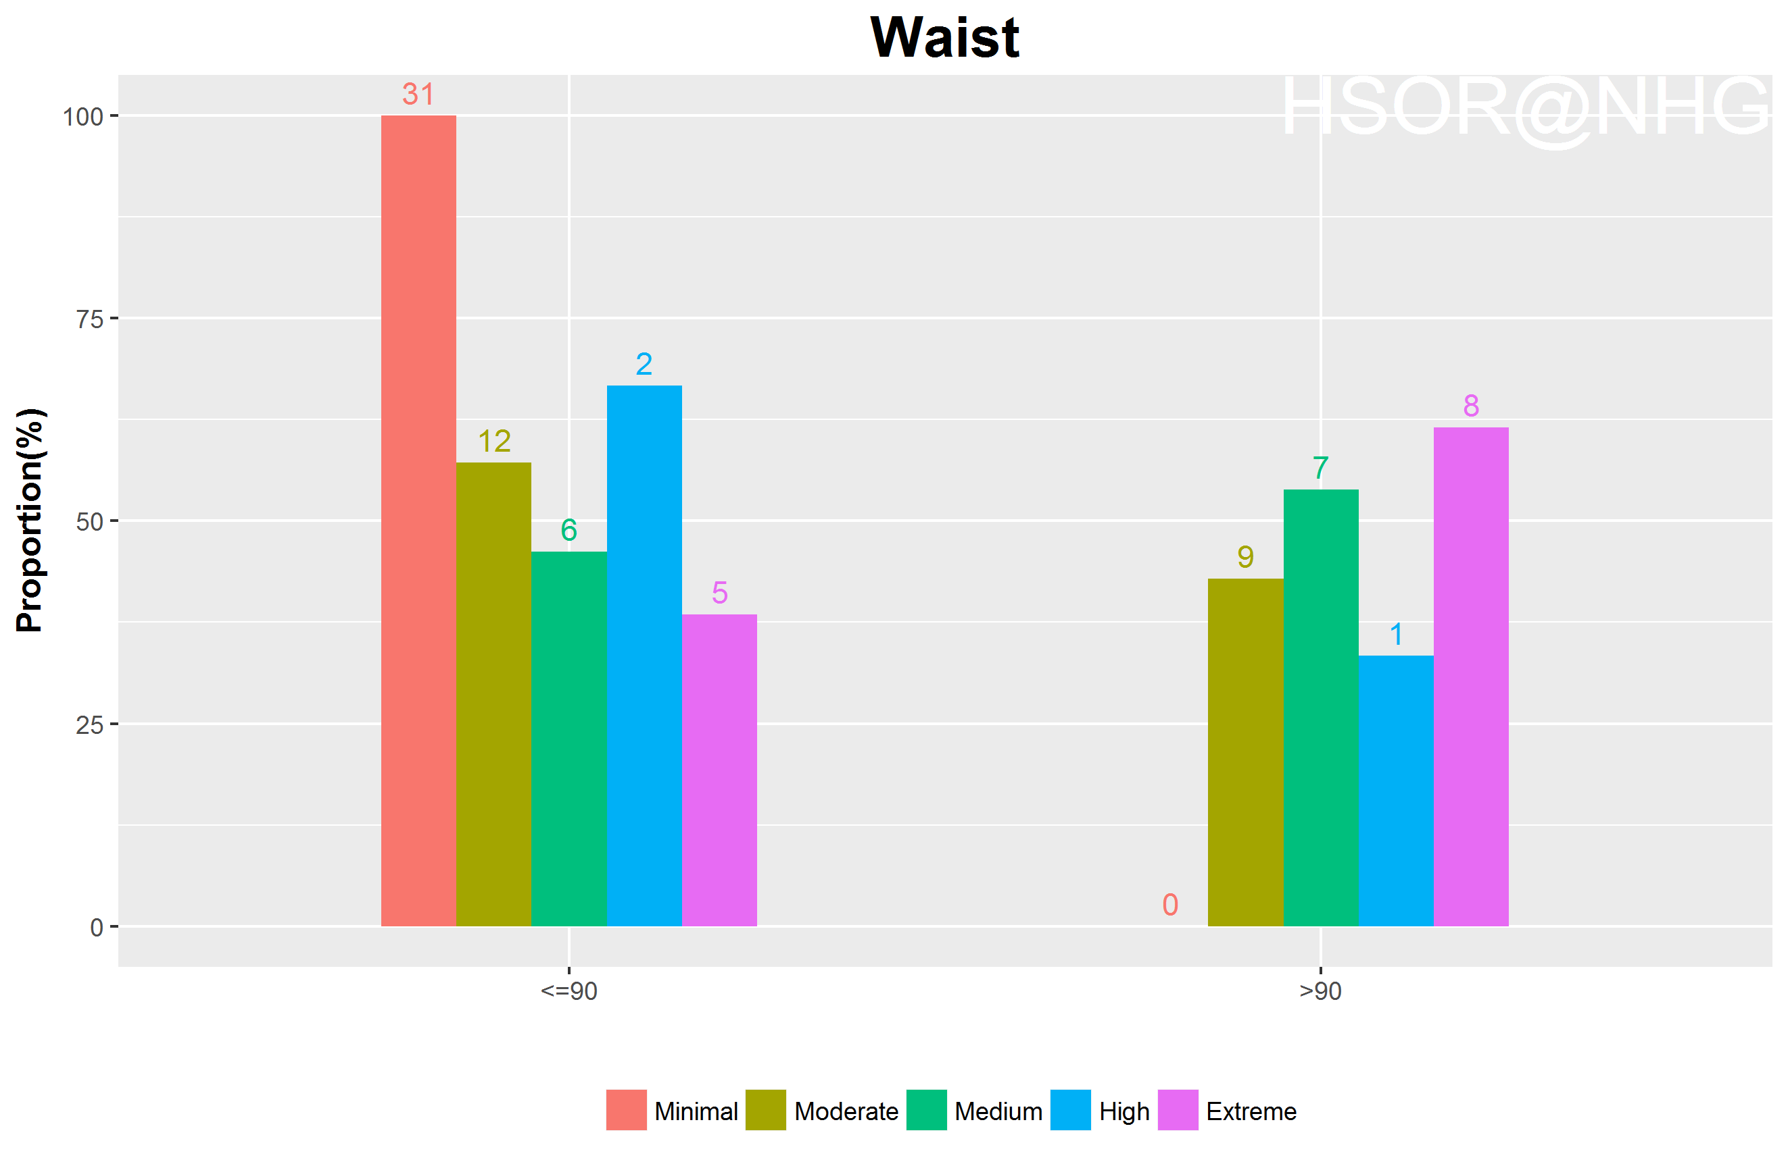
Waist vs risk cat.

Slide 24
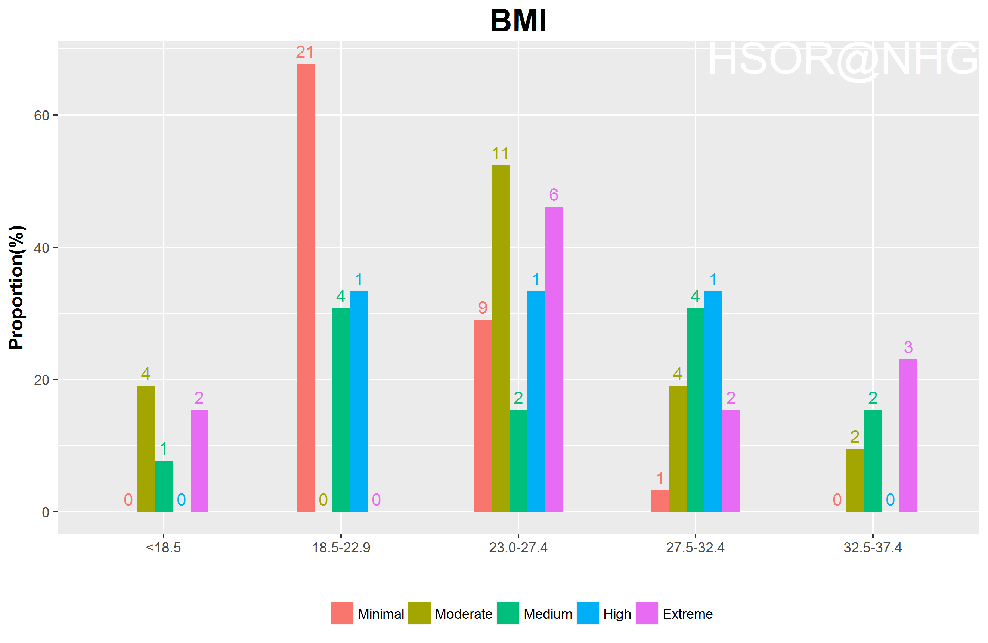
BMI category vs risk cat.

Slide 25
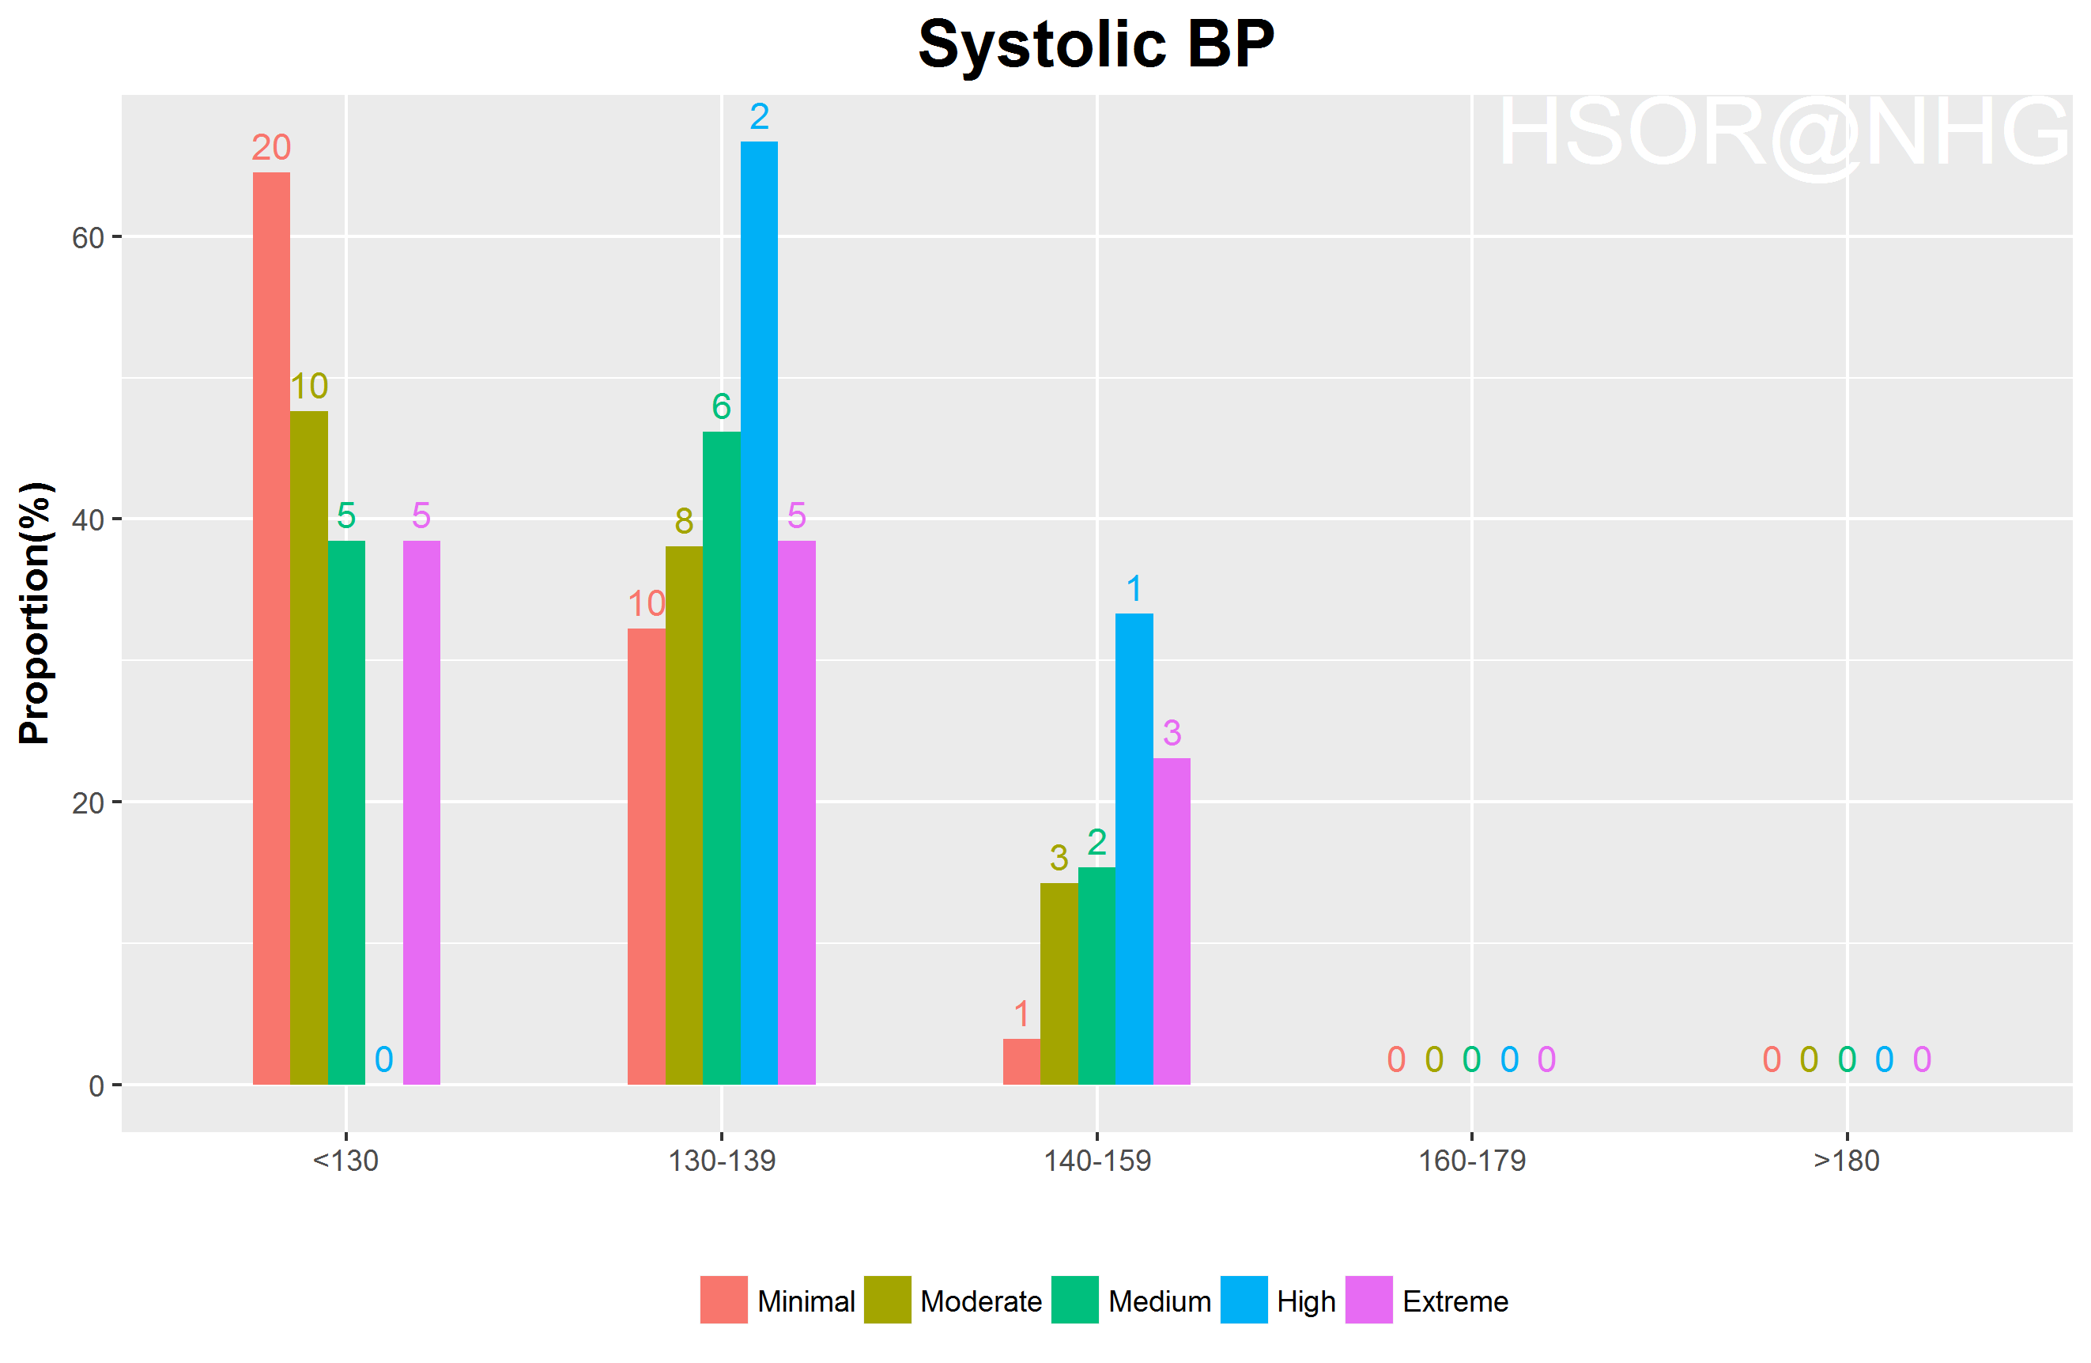
Blood Pressure (Sys) vs risk cat.

Slide 26
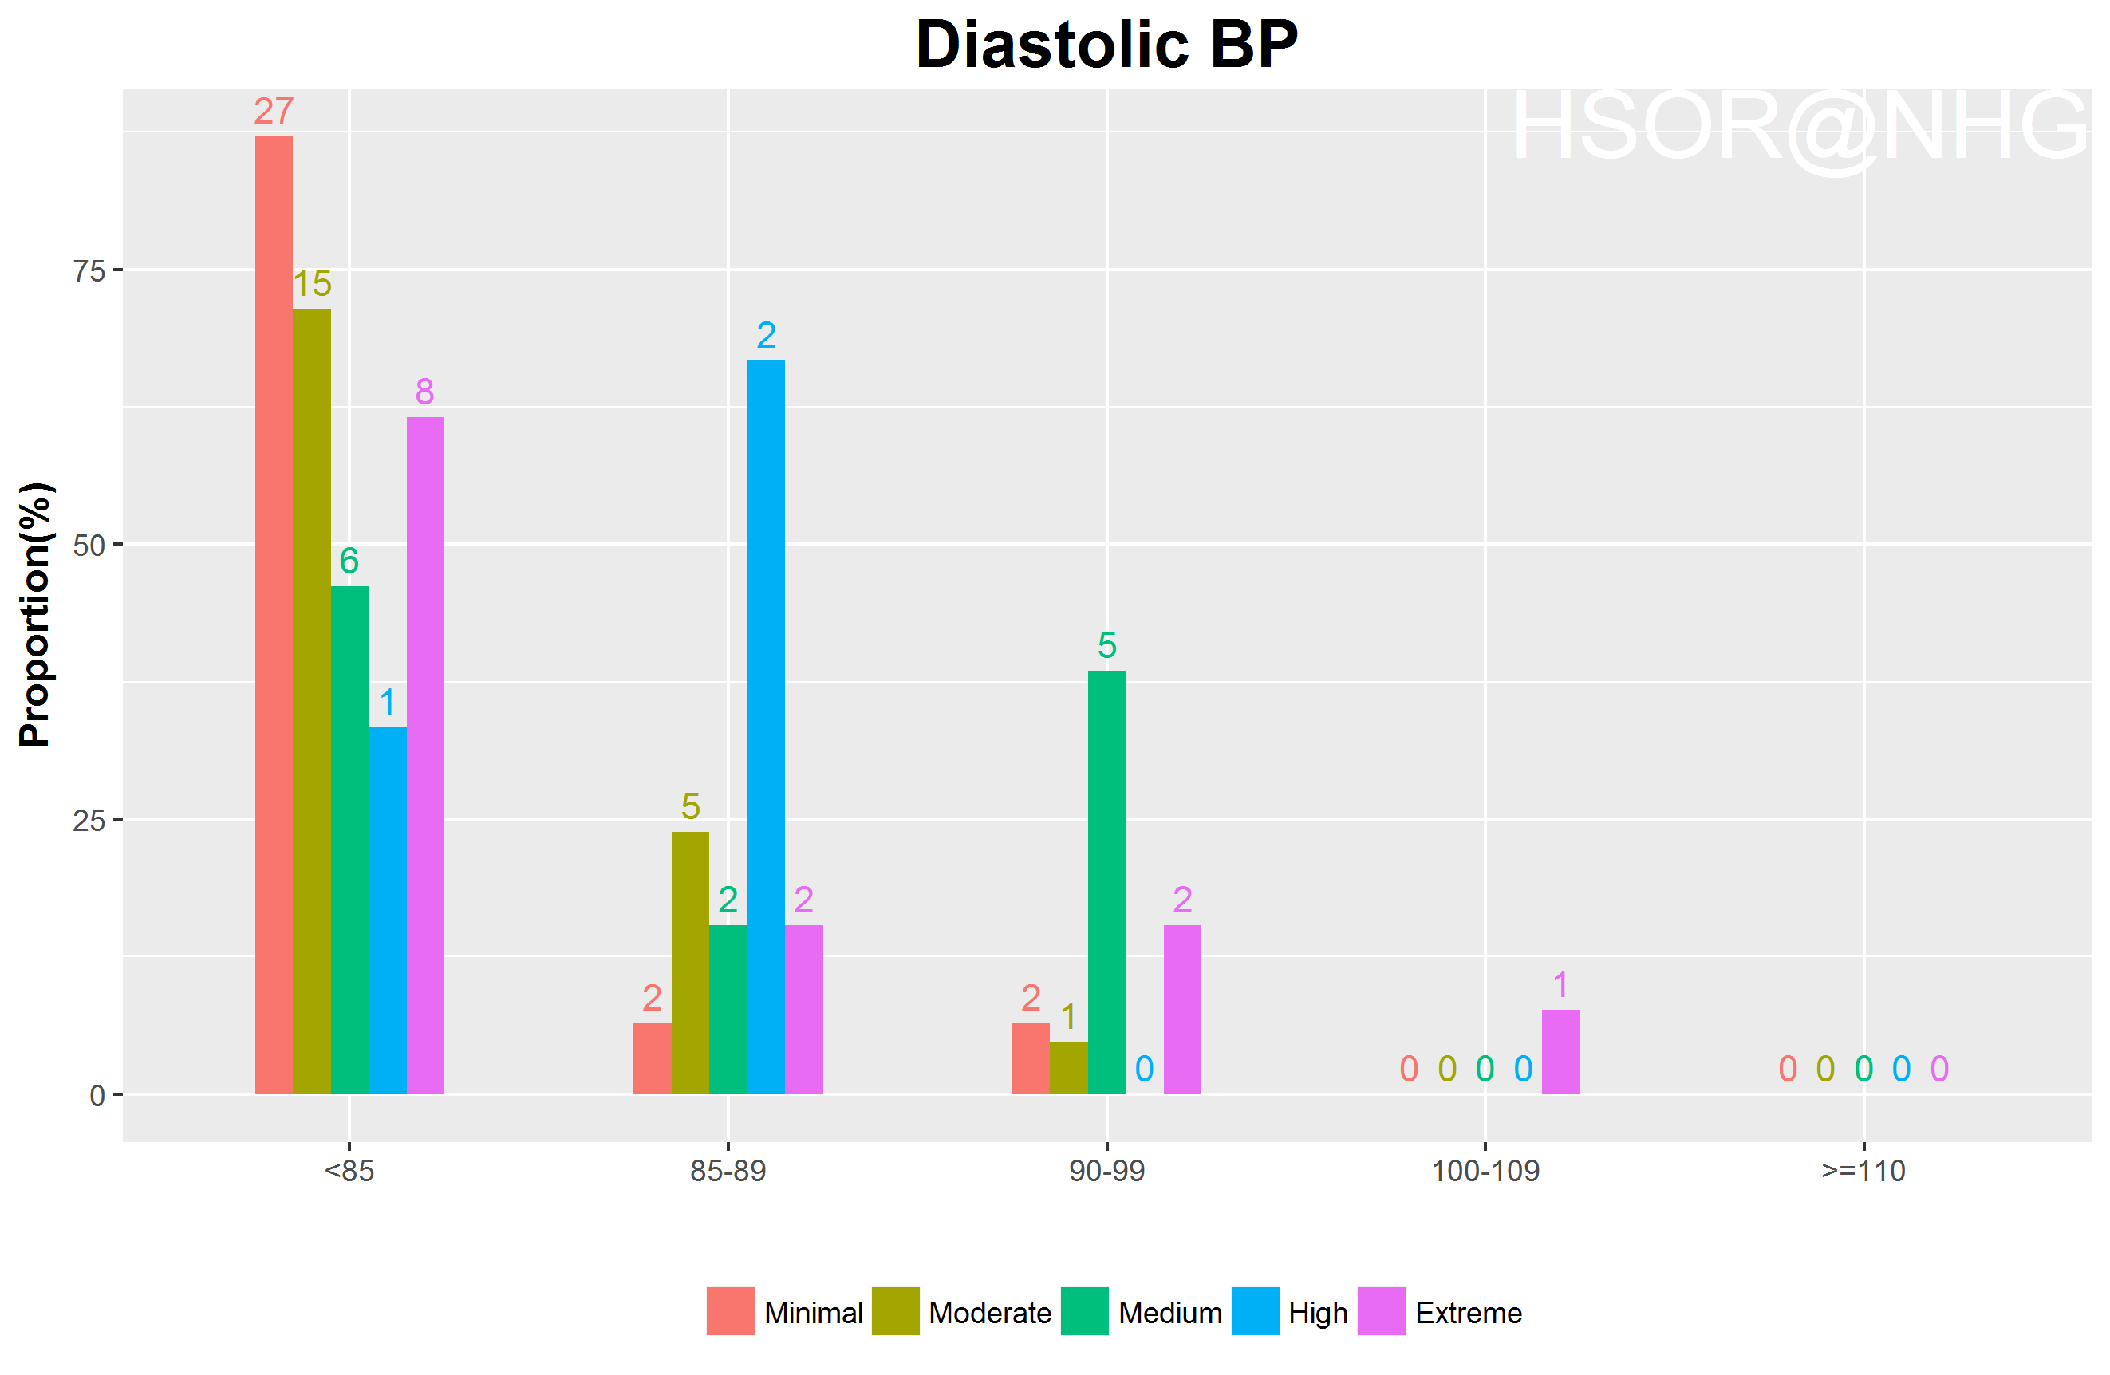
Blood Pressure (Dia) vs risk cat.

Slide 27
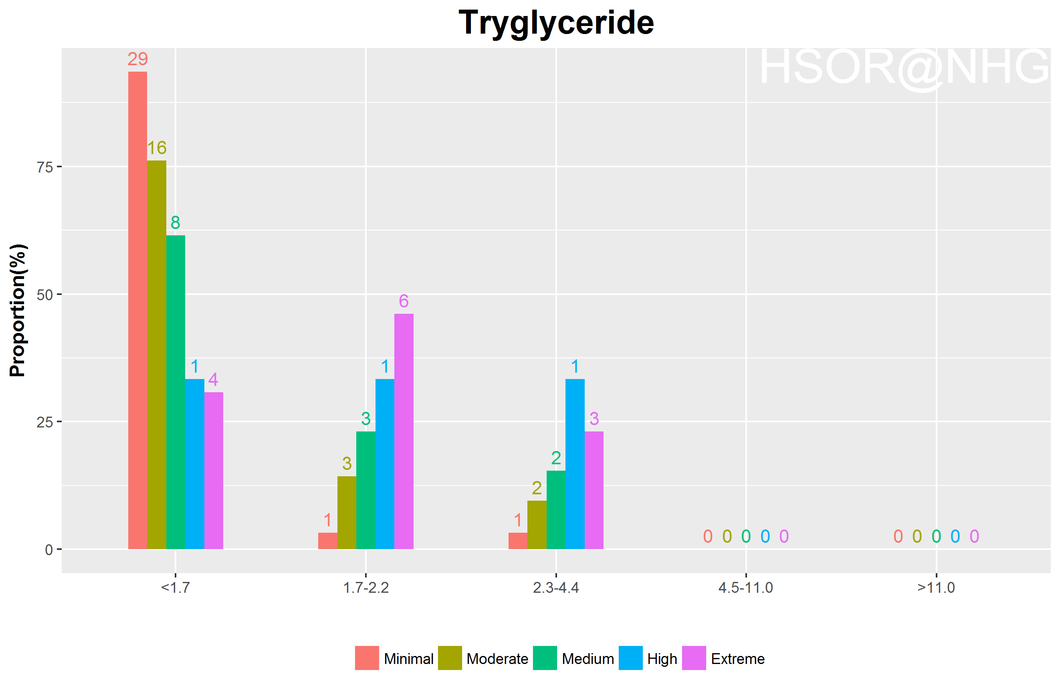
Tryglyceride vs risk cat.

Slide 28
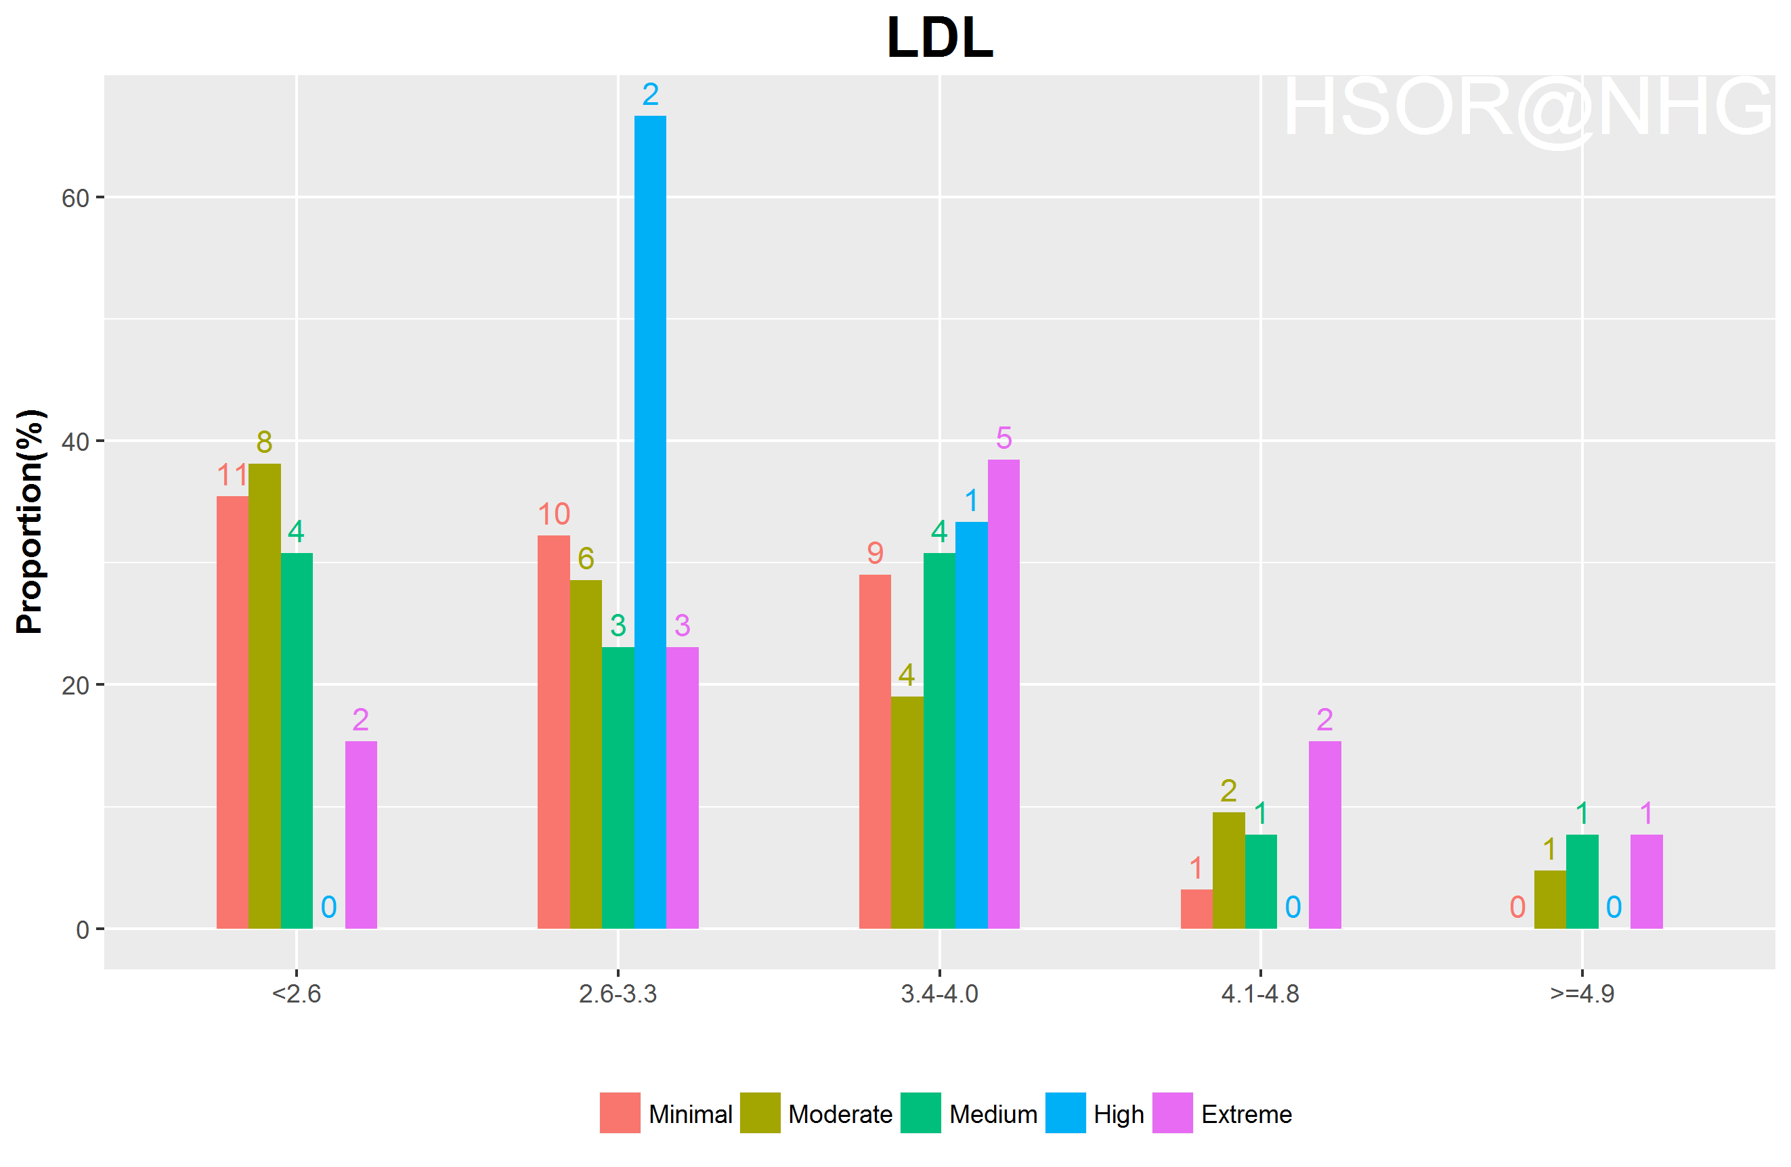
LDL vs risk cat.

Slide 29
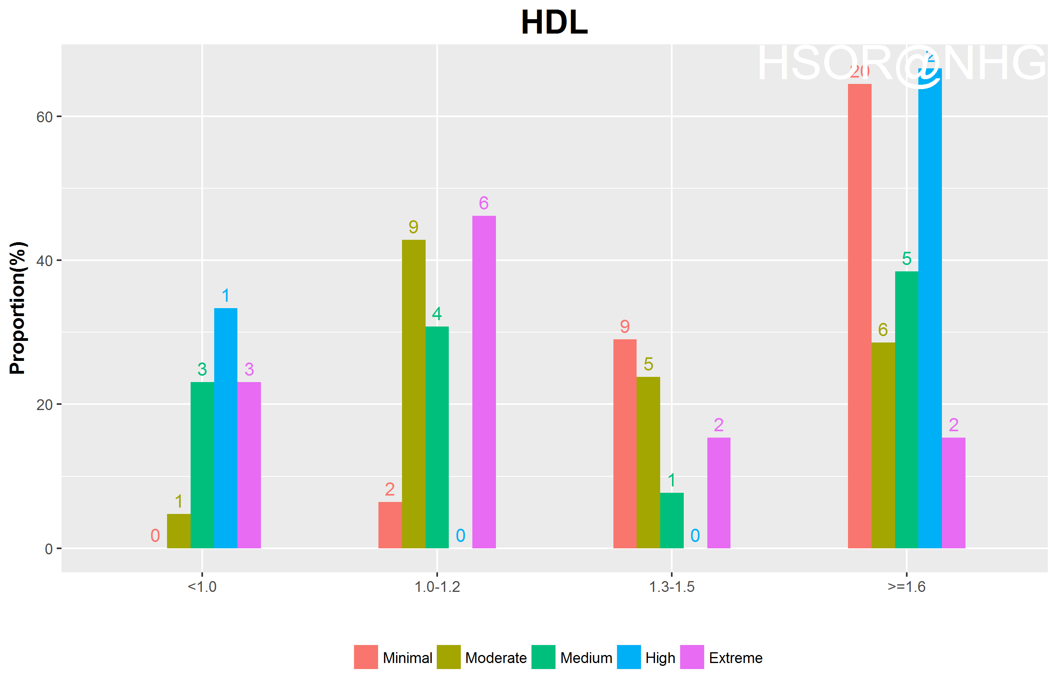
HDL vs risk cat.

Slide 30
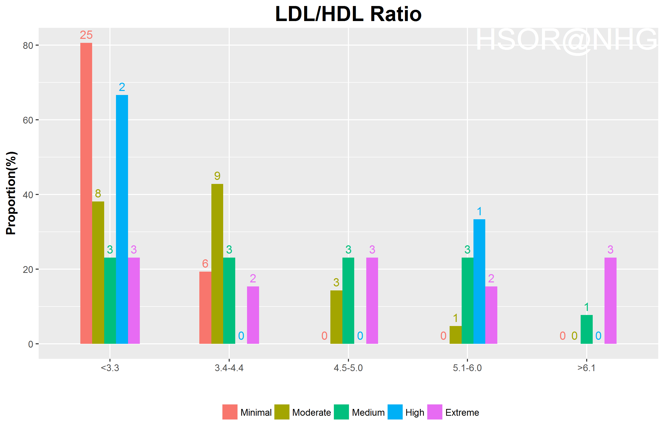
LDL/HDL ratio vs risk cat.

